Slide 1
AutoML

Slide 2
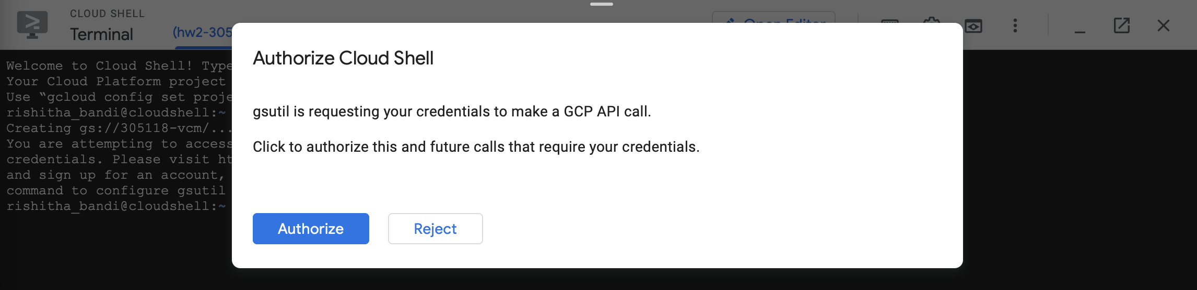
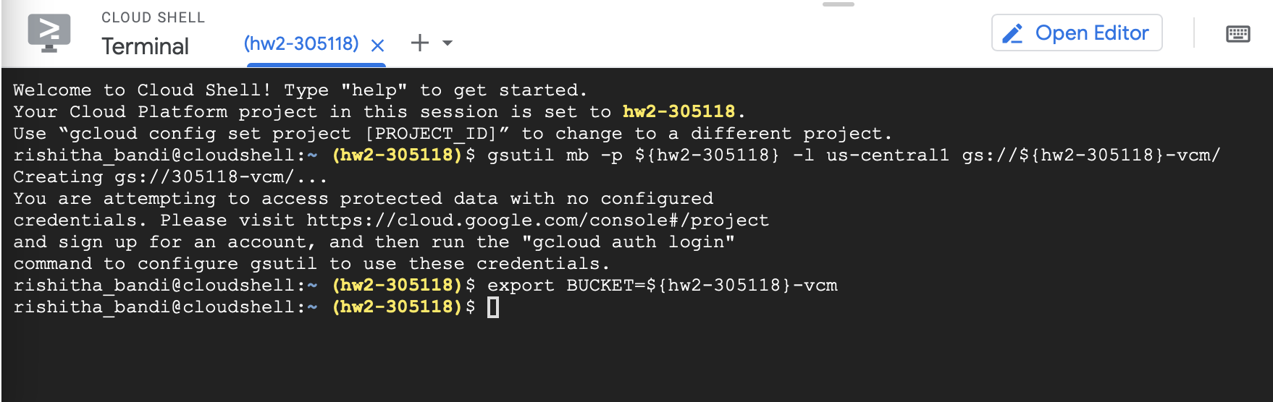
Image data
After enabling billing and API and providing required access.
Bucket is created using command below
gsutil mb -p hw2-30518 -l us-central1 gs://hw2-30518/hw2-images

Slide 3
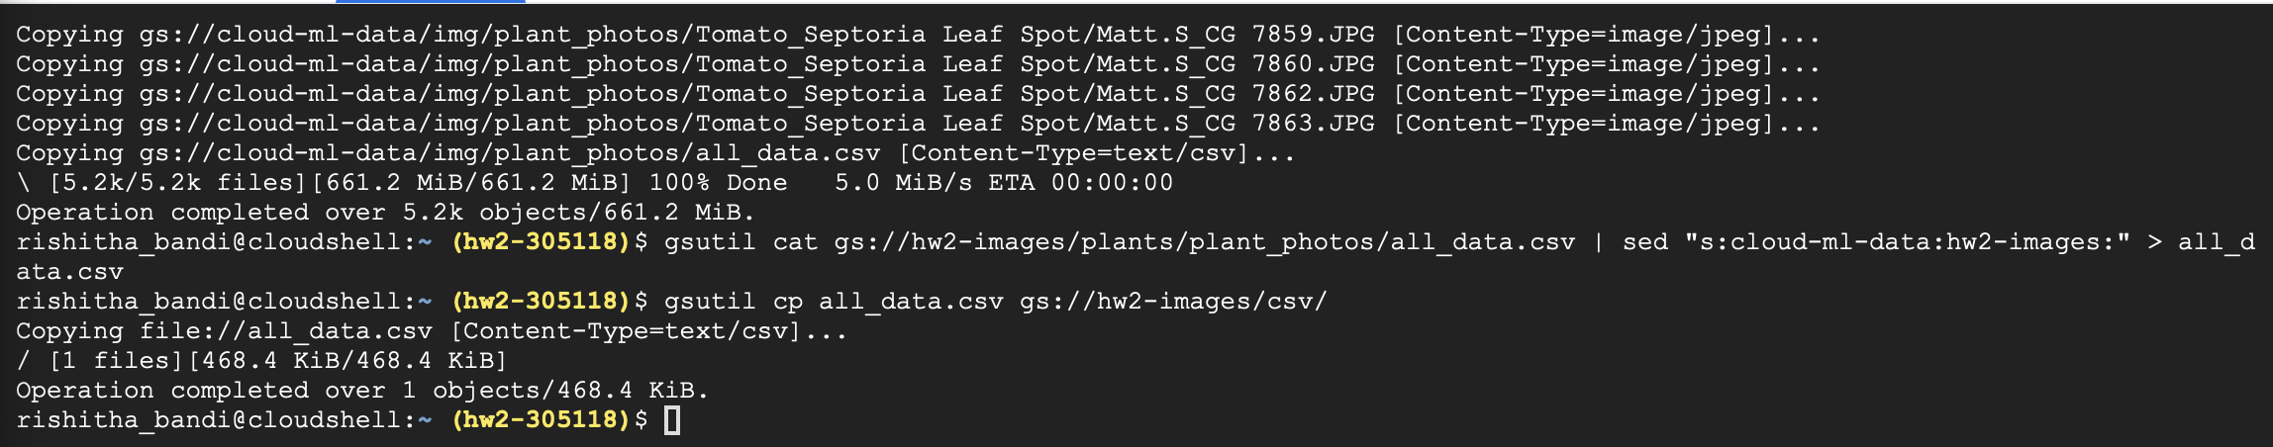
Below is screenshot of copying the dataset from cloud bucket to storage bucket created previously.

Slide 4
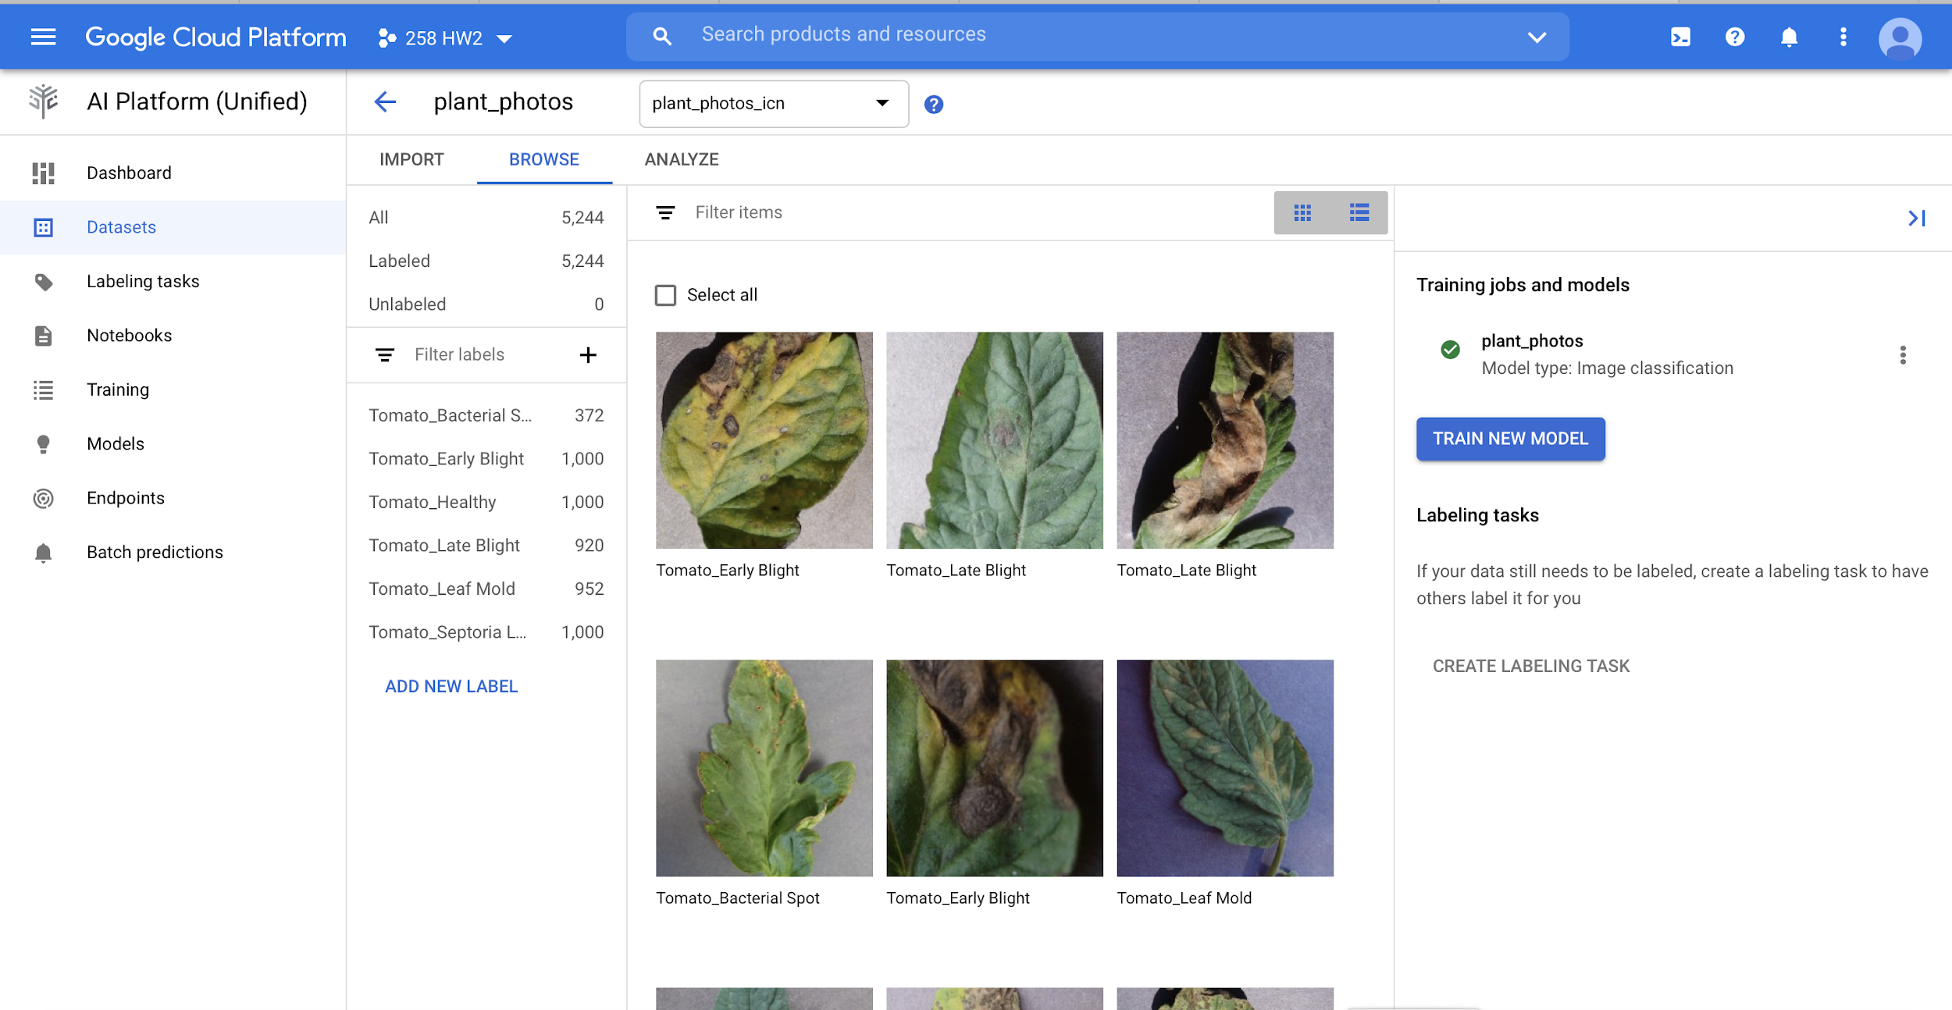
Dataset is created from the cloud bucket

Slide 5
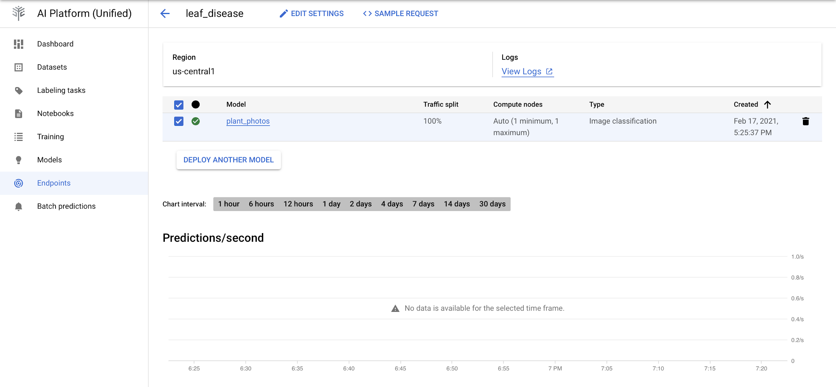
Endpoint is created for testing after model is deployed

Slide 6
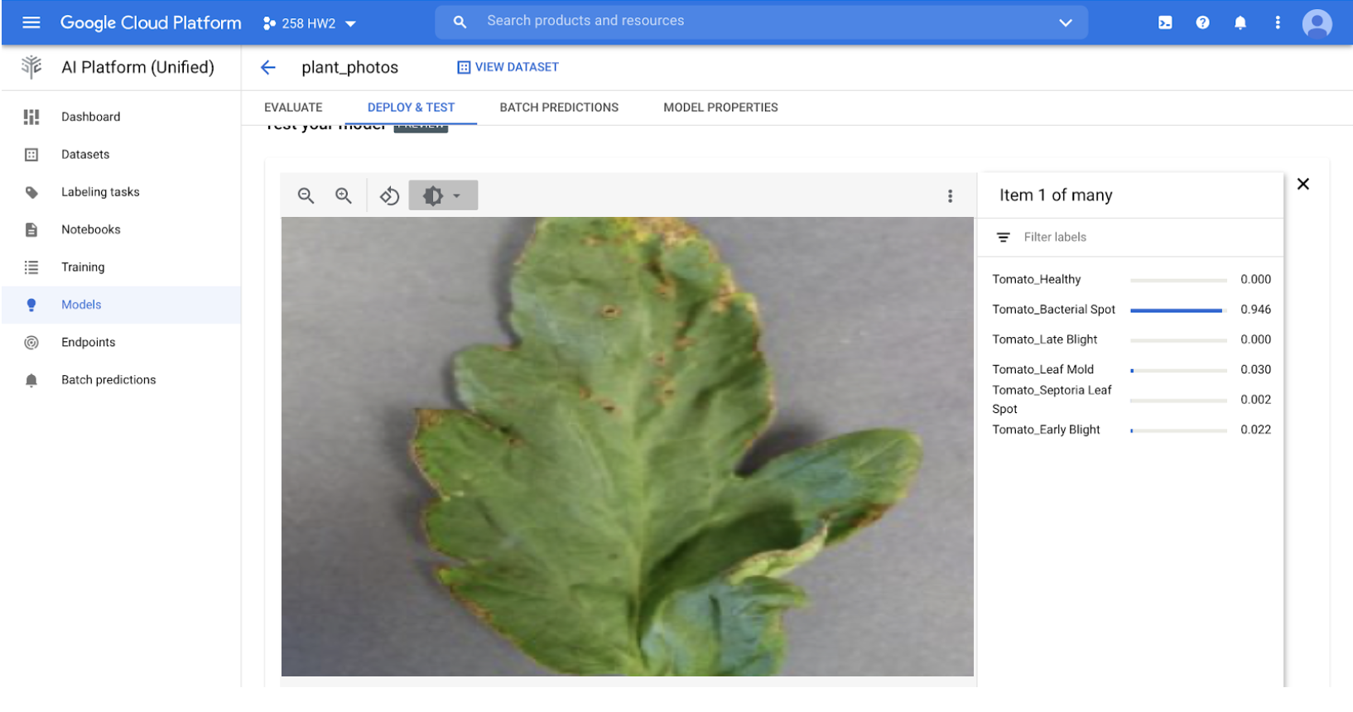

Slide 7
Text data
Create test-classification bucket
Copy dataset from cloud storage to project bucket

Slide 8
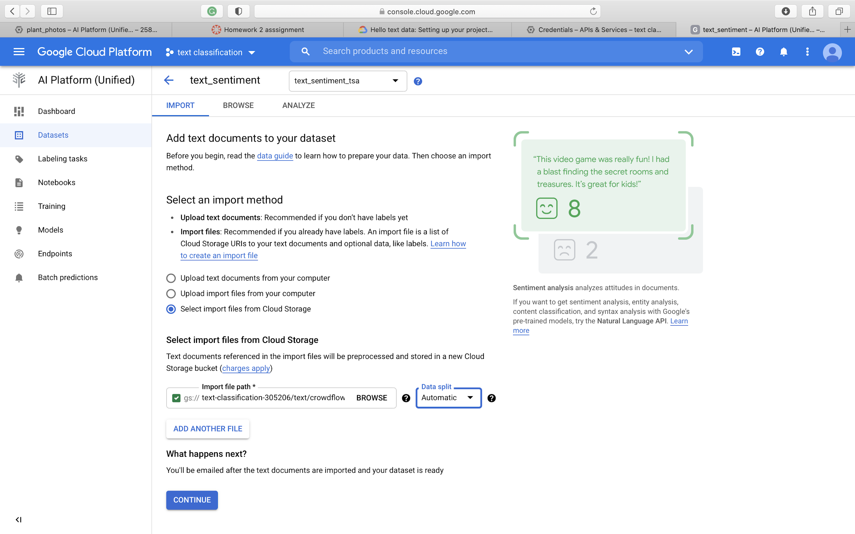
Upload dataset from storage bucket

Slide 9
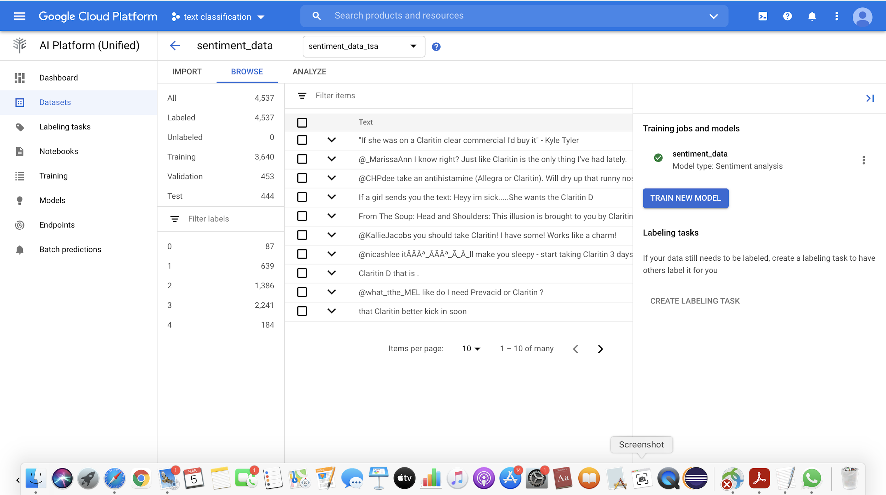

Slide 10
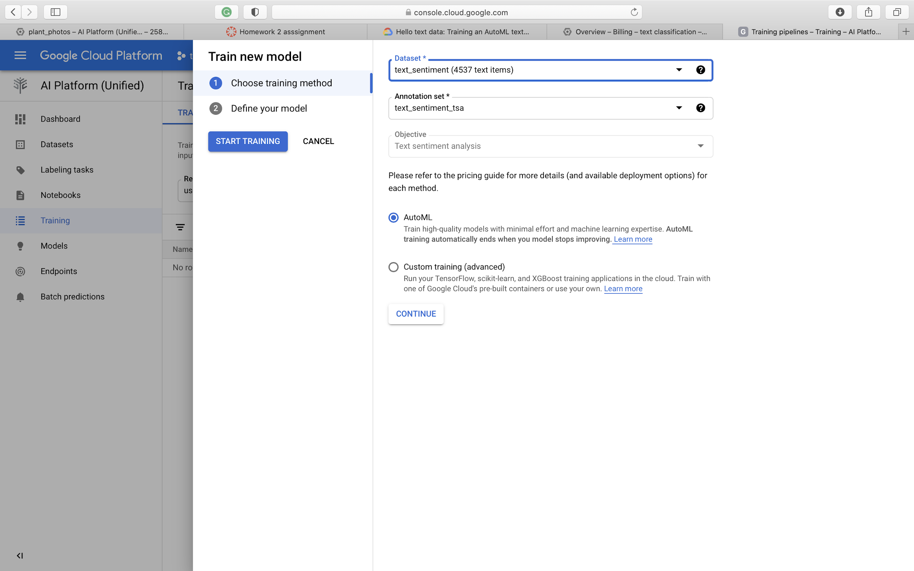
Train the model

Slide 11
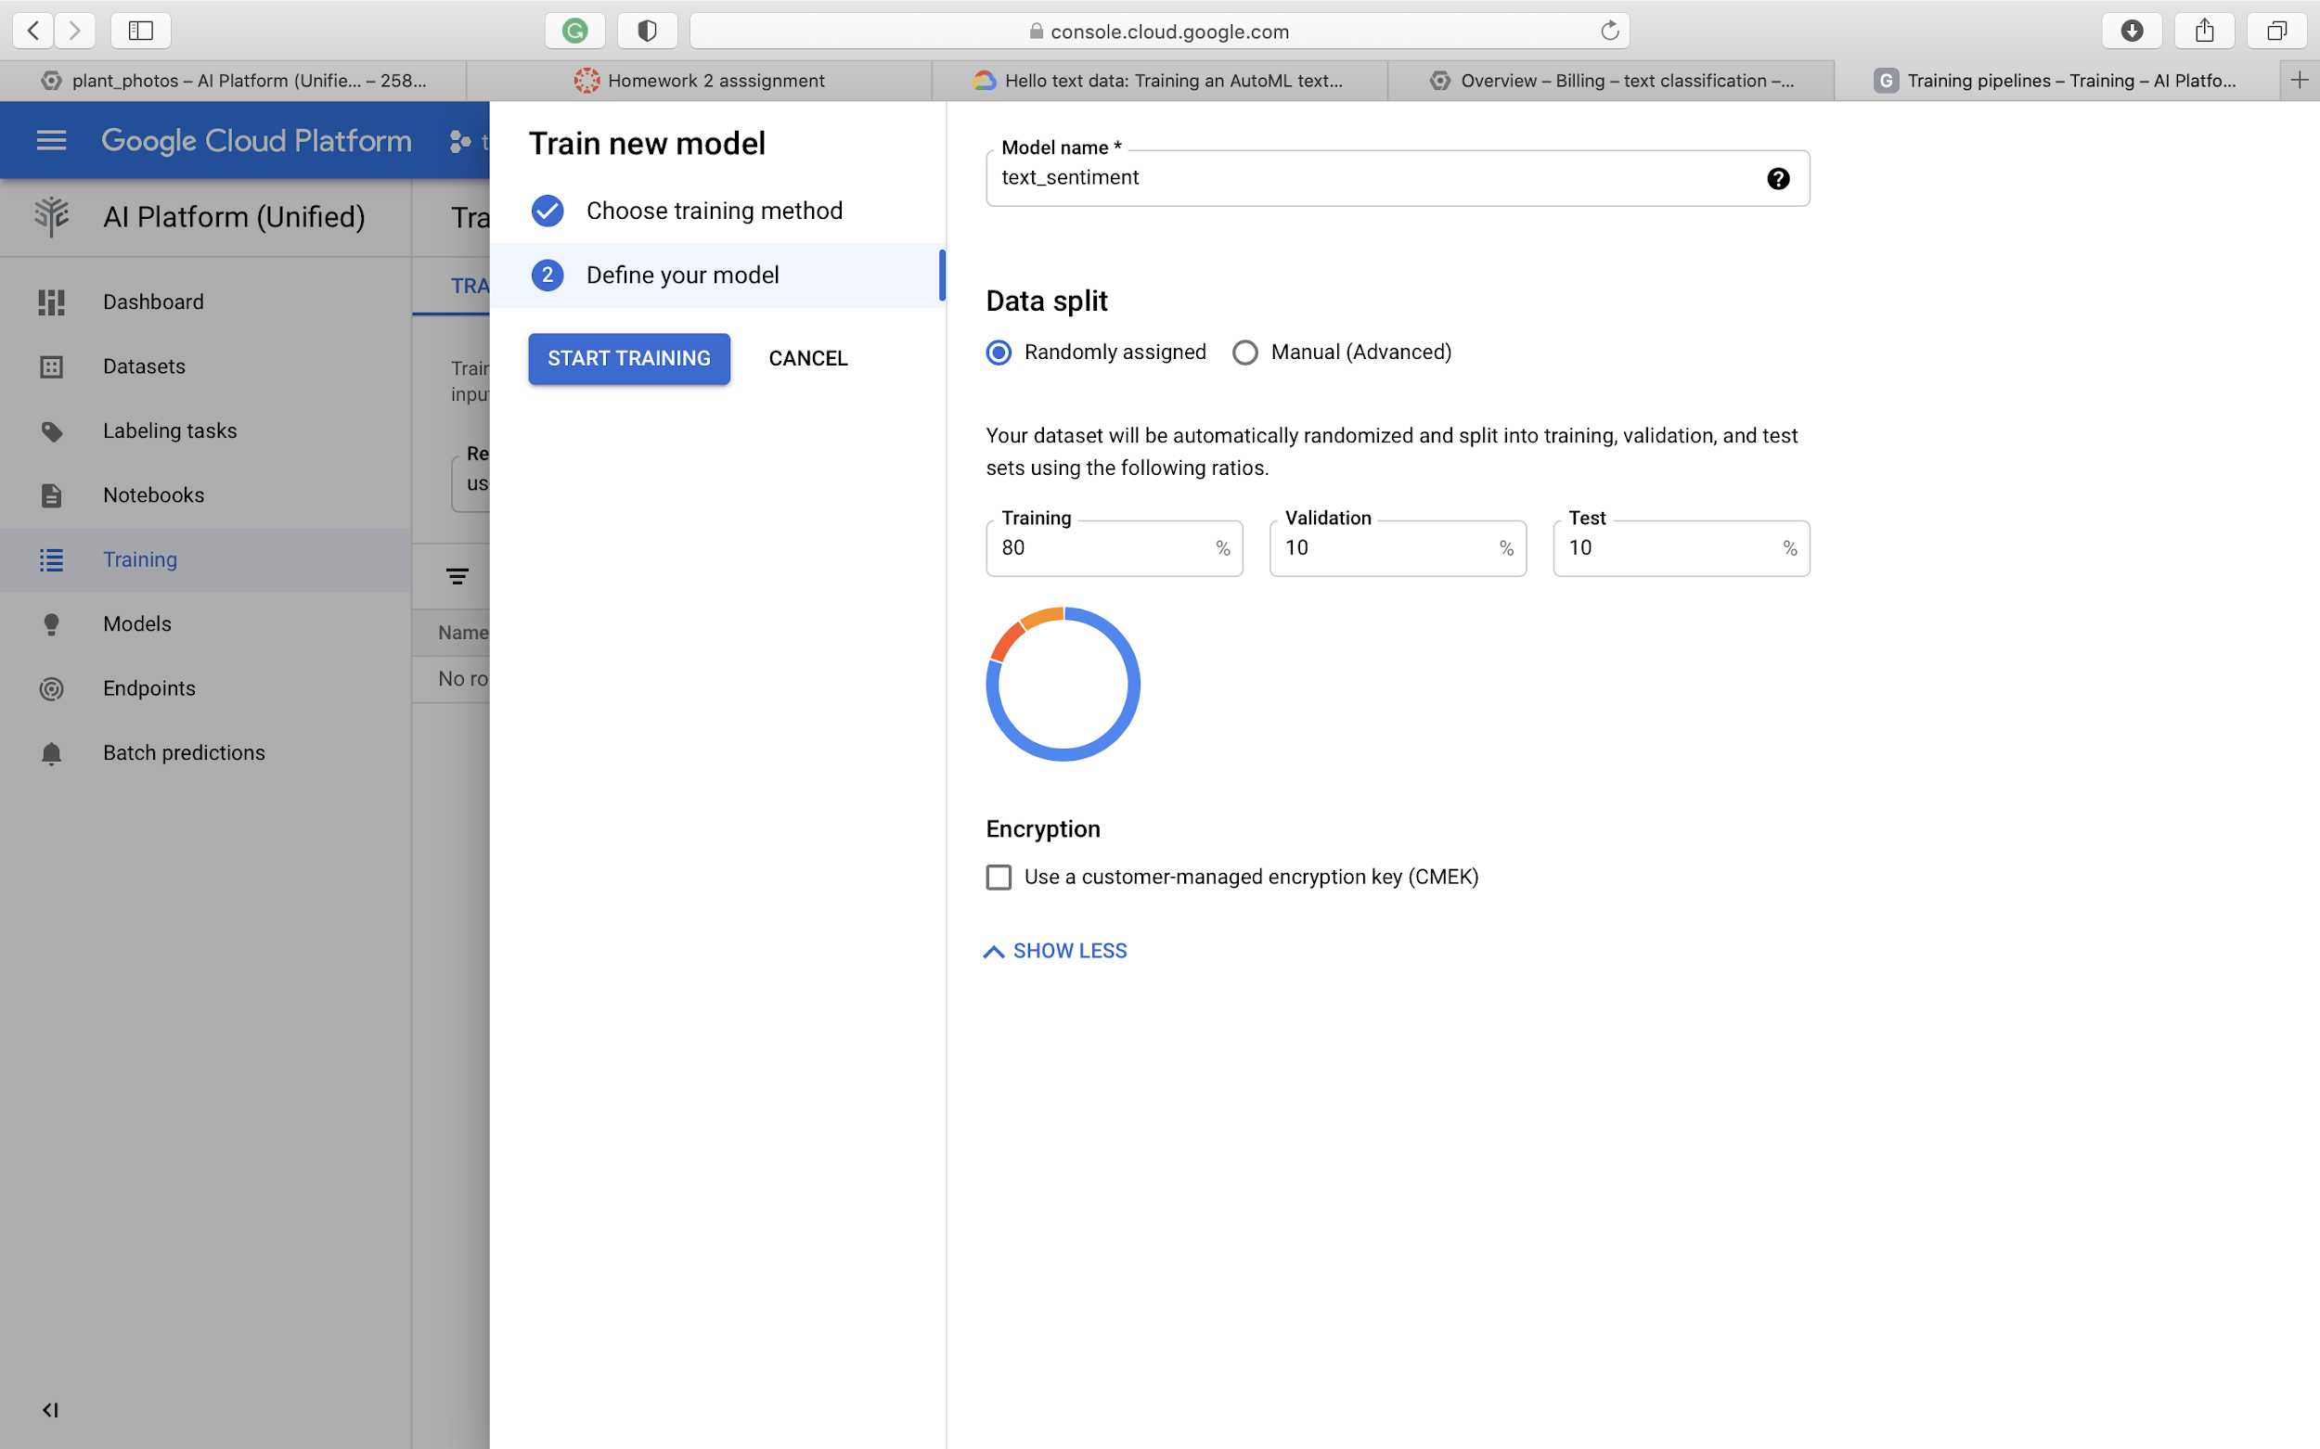

Slide 12
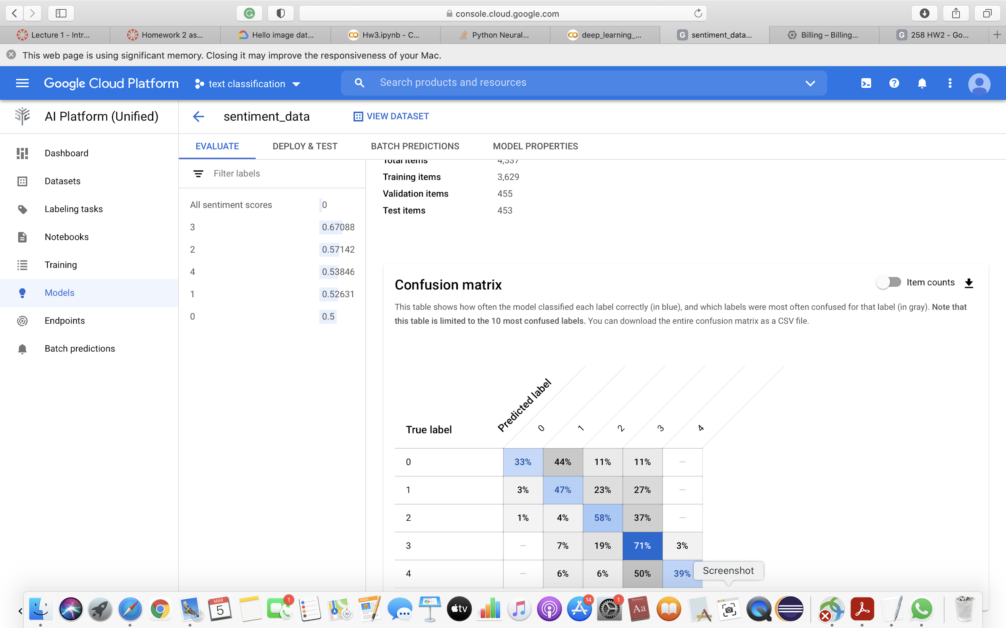

Slide 13
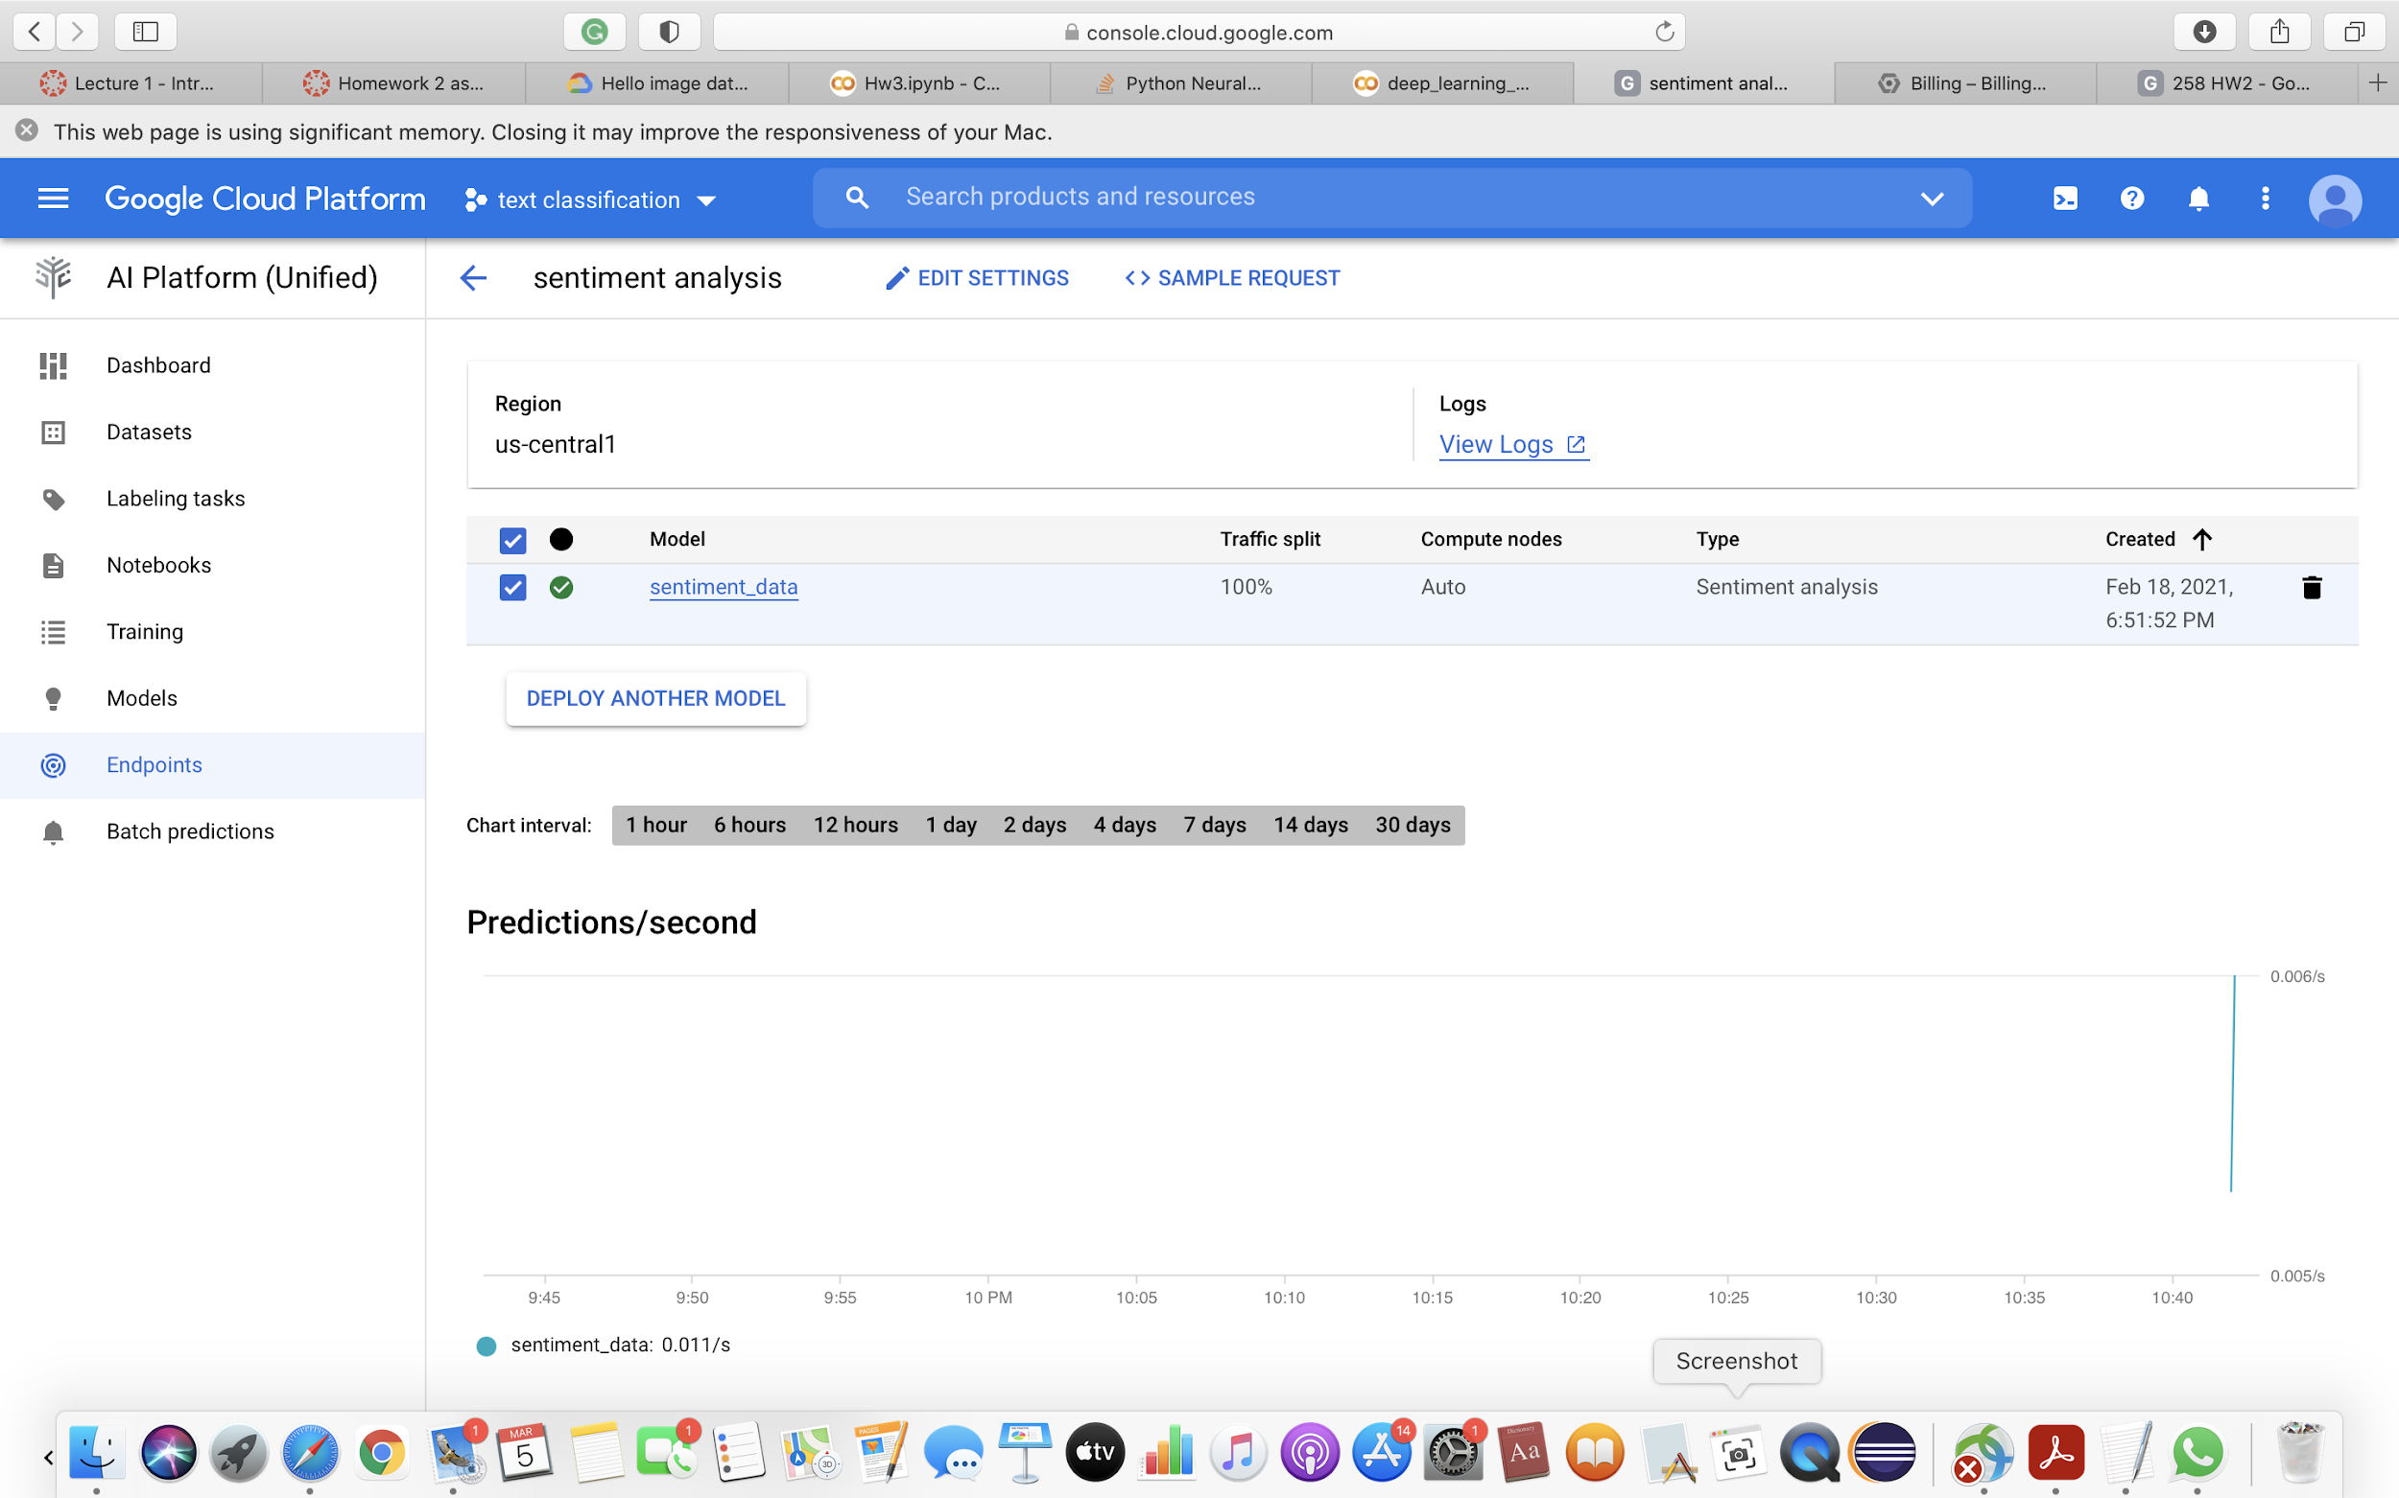
Create the endpoint to test model

Slide 14
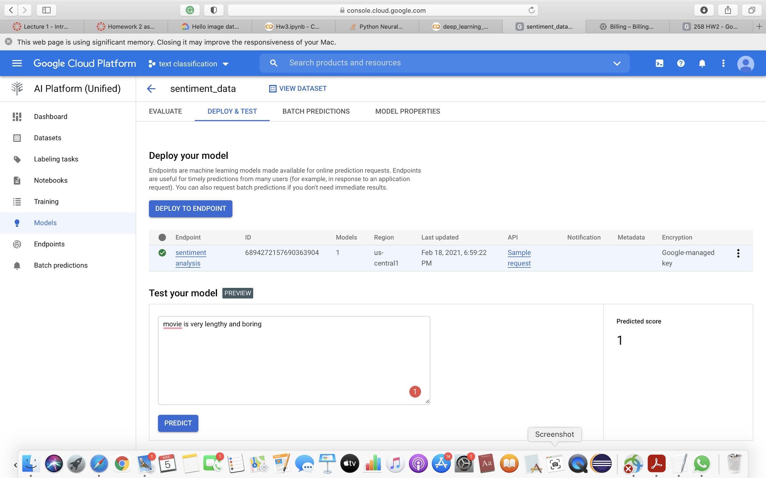

Slide 15
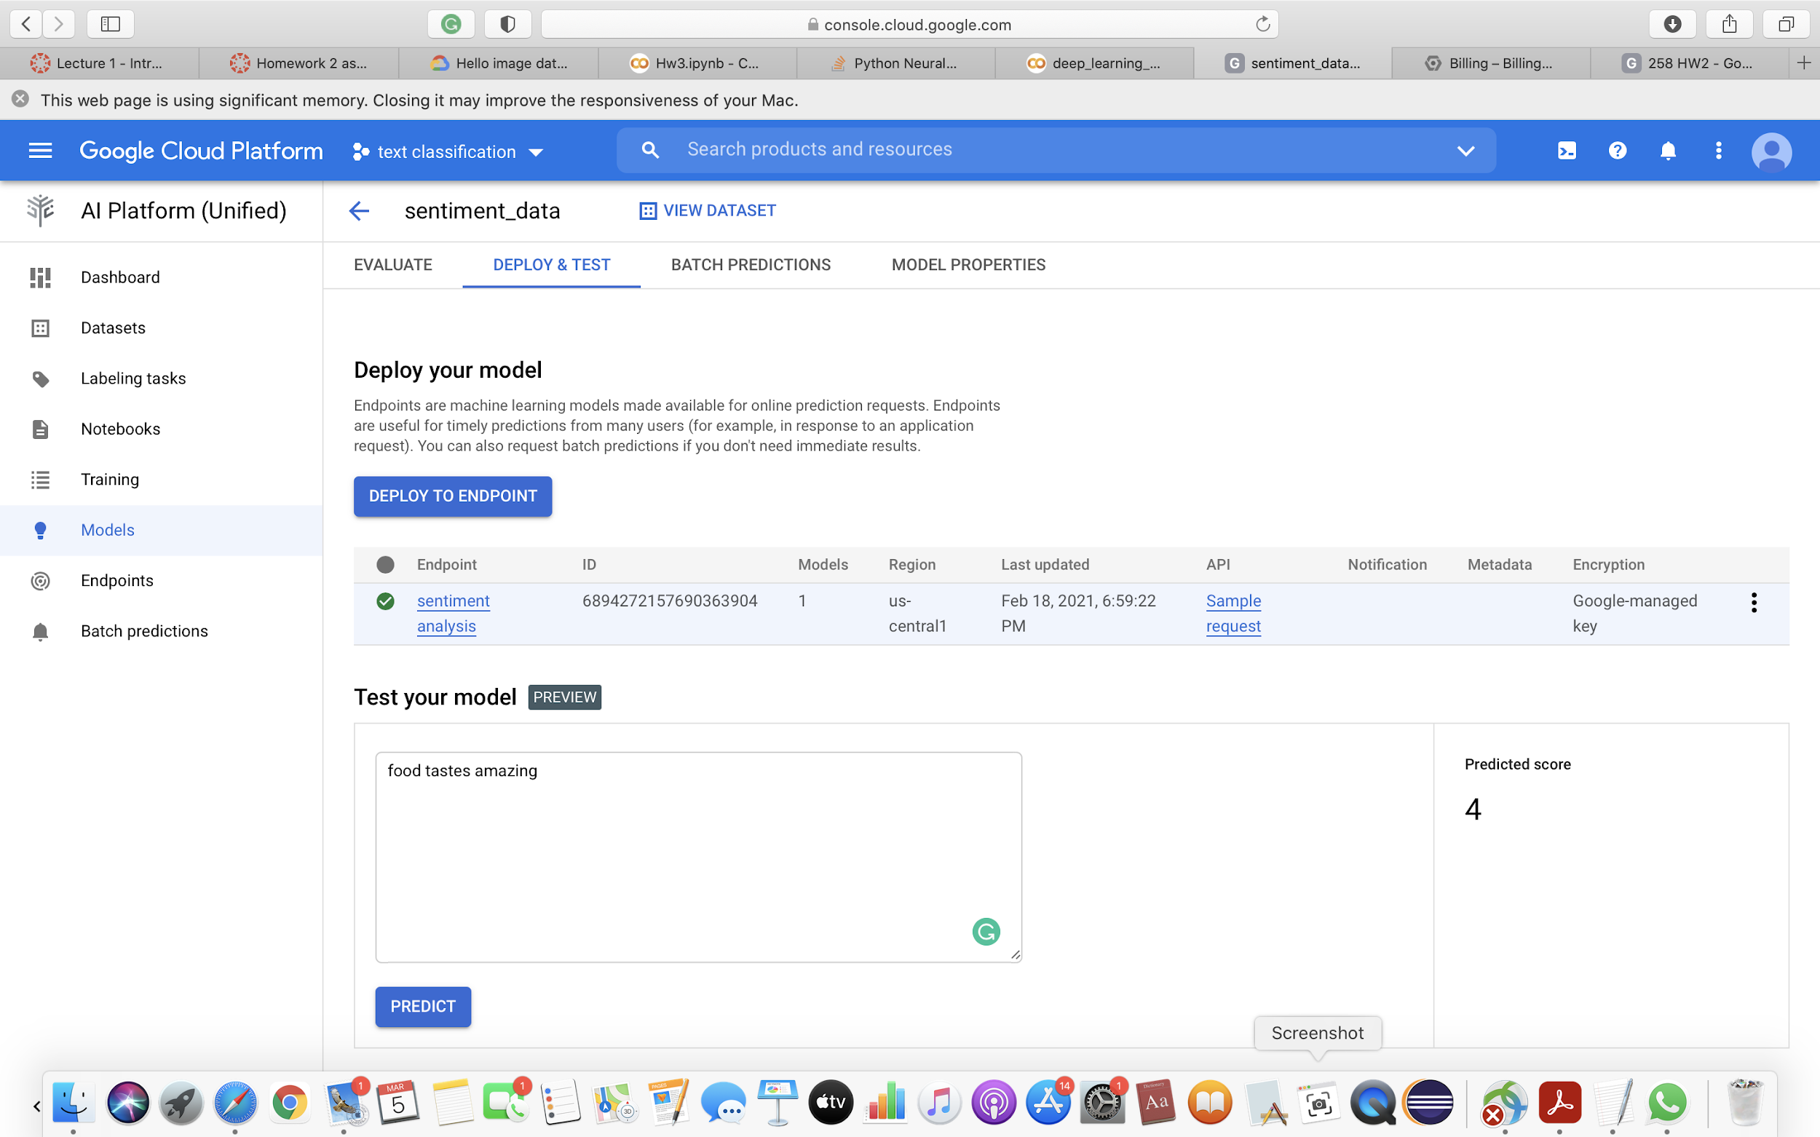

Slide 16
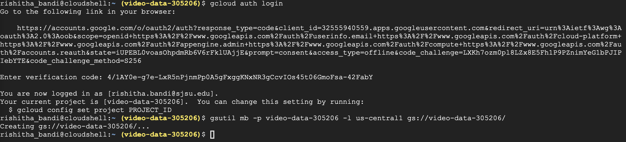
Video data
Create storage bucket

Slide 17
Copy dataset from google cloud bucket to the storage bucket

Slide 18
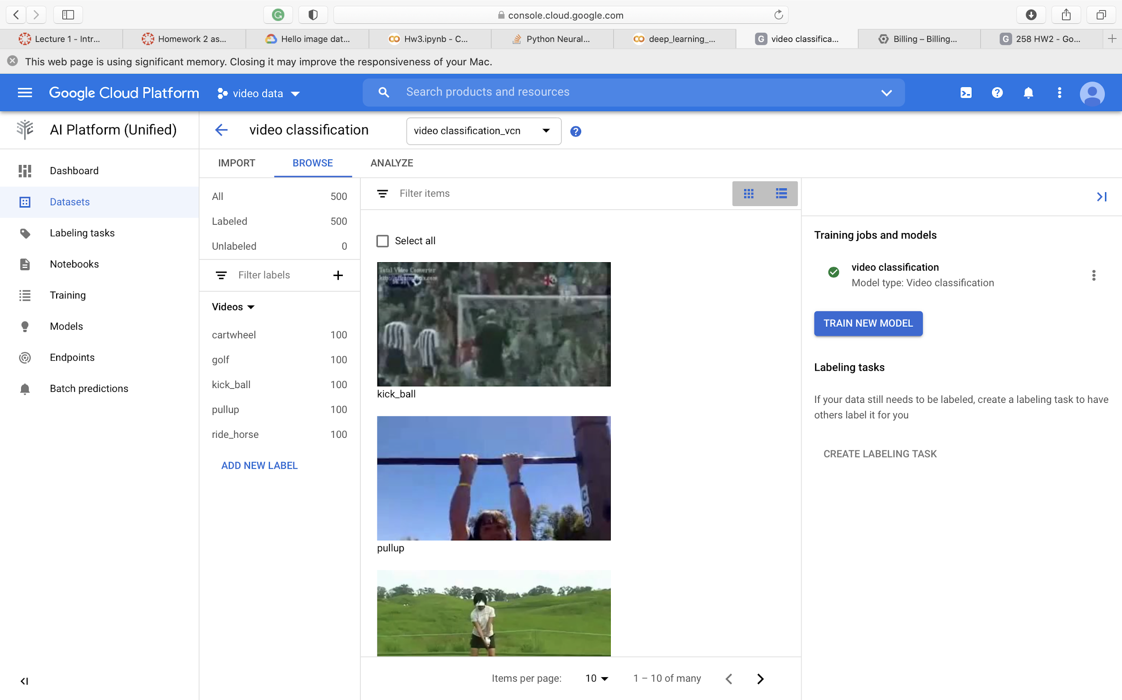
upload dataset from storage bucket

Slide 19
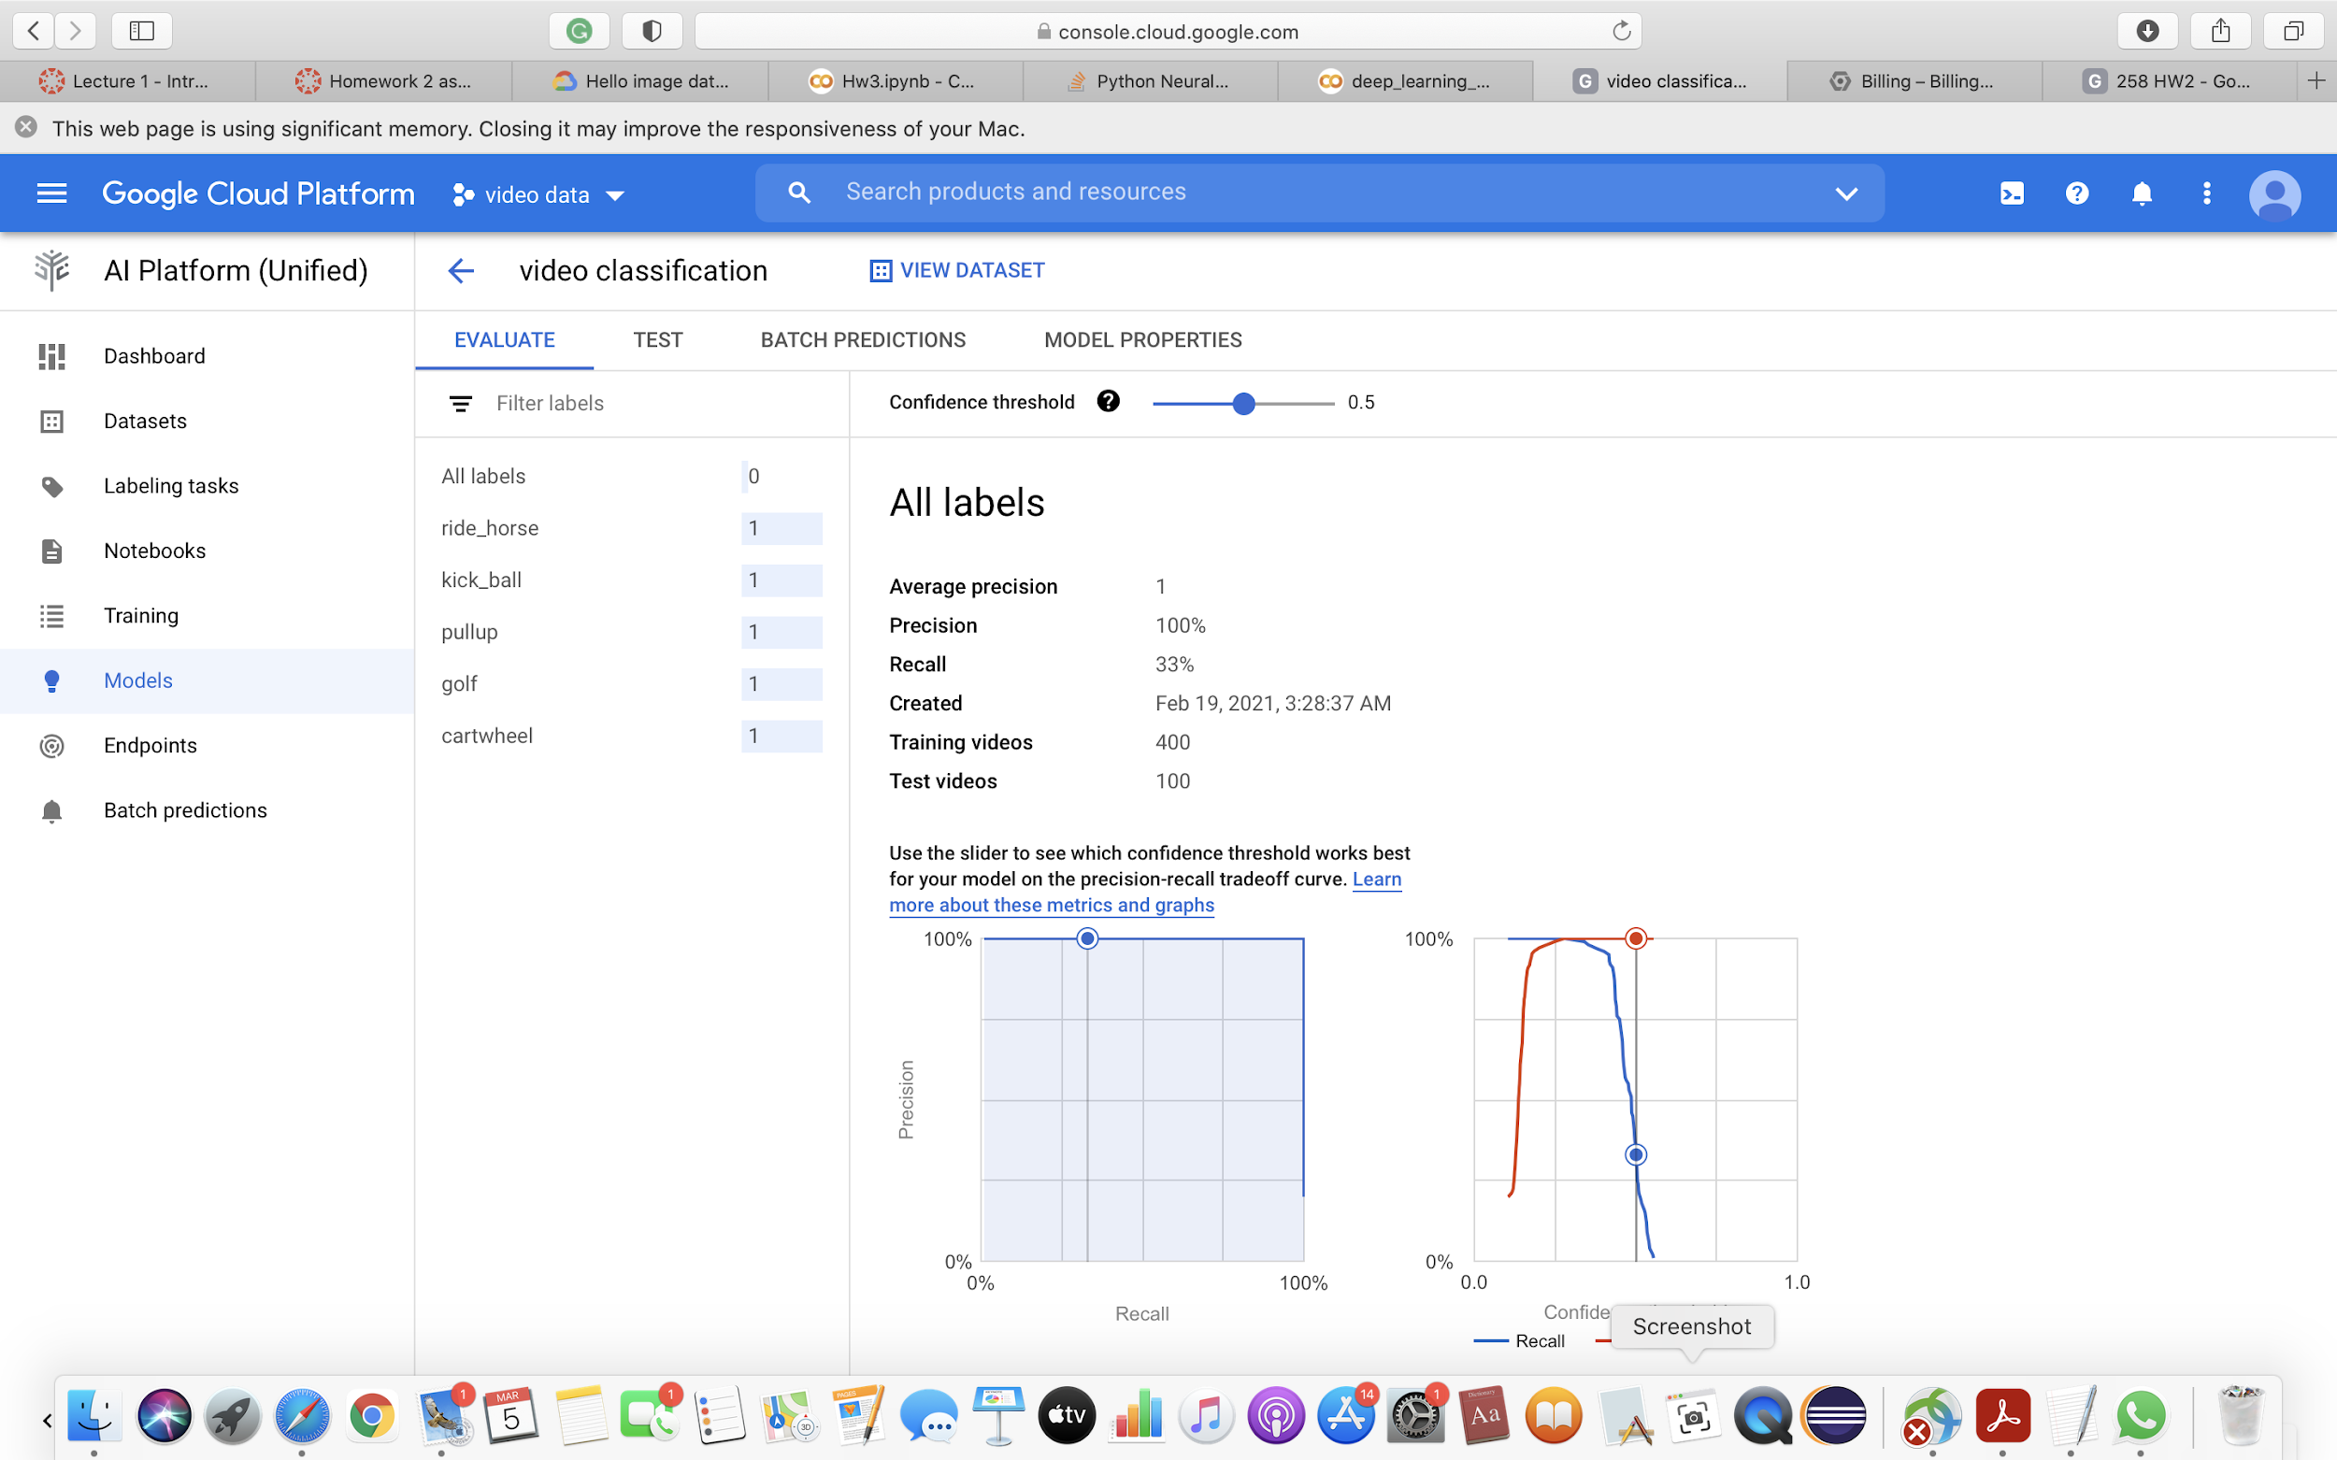
Deploy the model

Slide 20
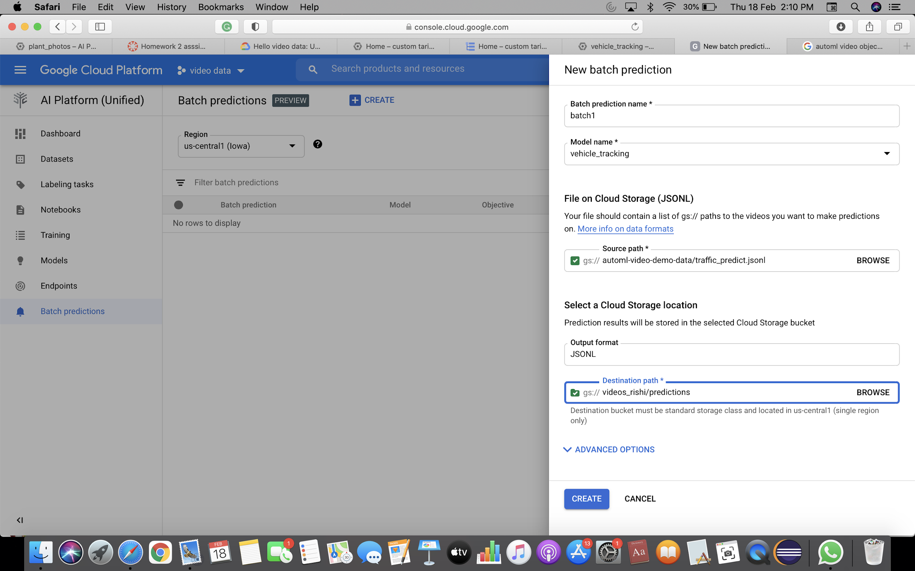
Create batch prediction for testing

Slide 21
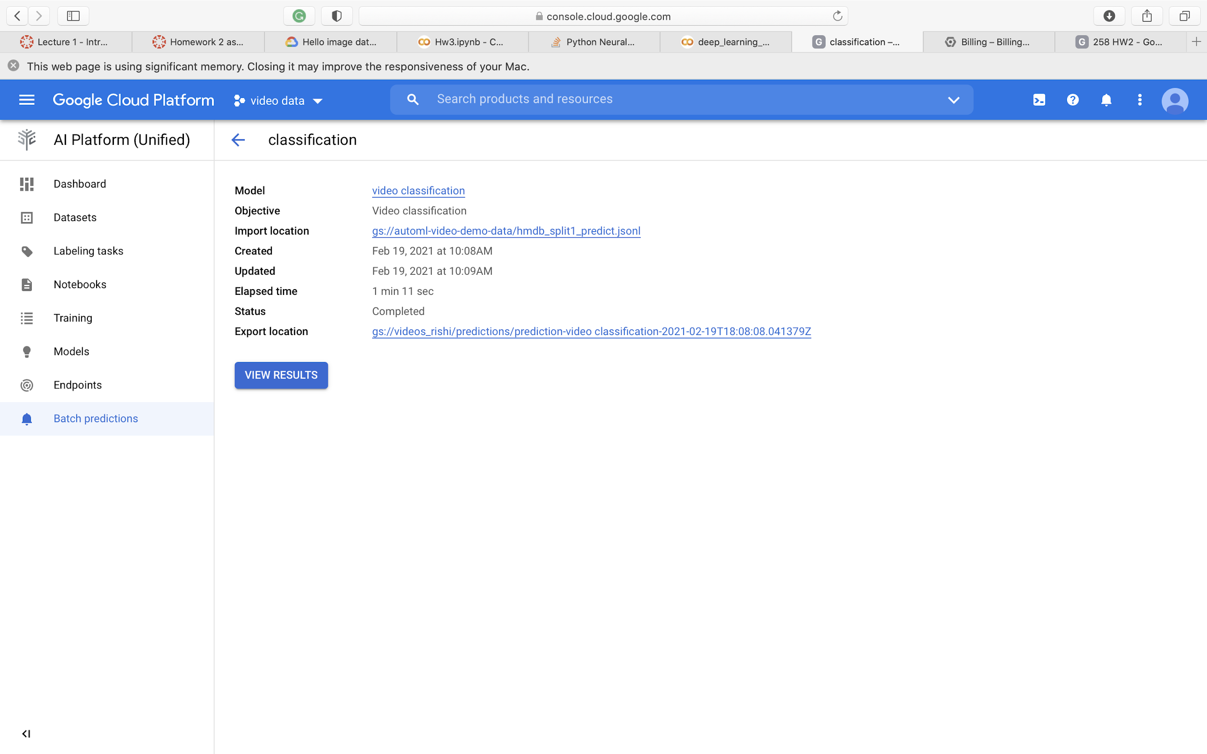

Slide 22


Slide 23
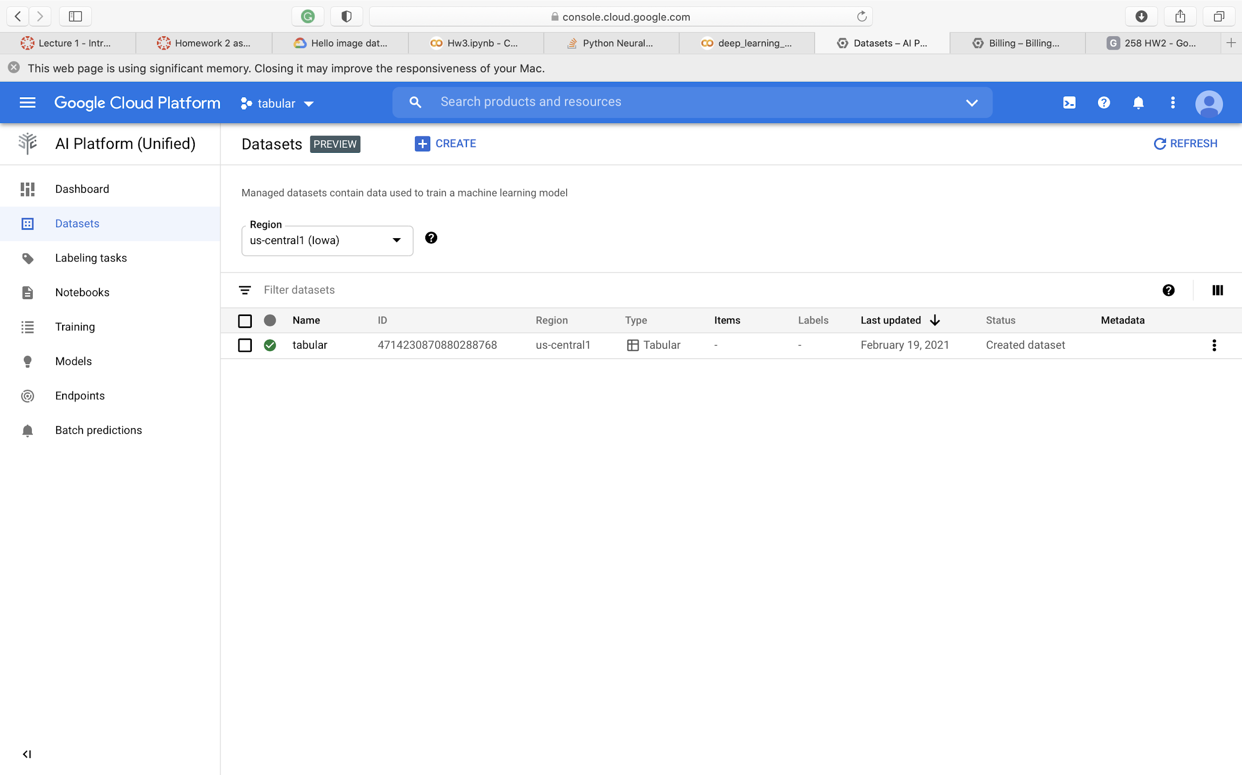
Tabular data

Slide 24
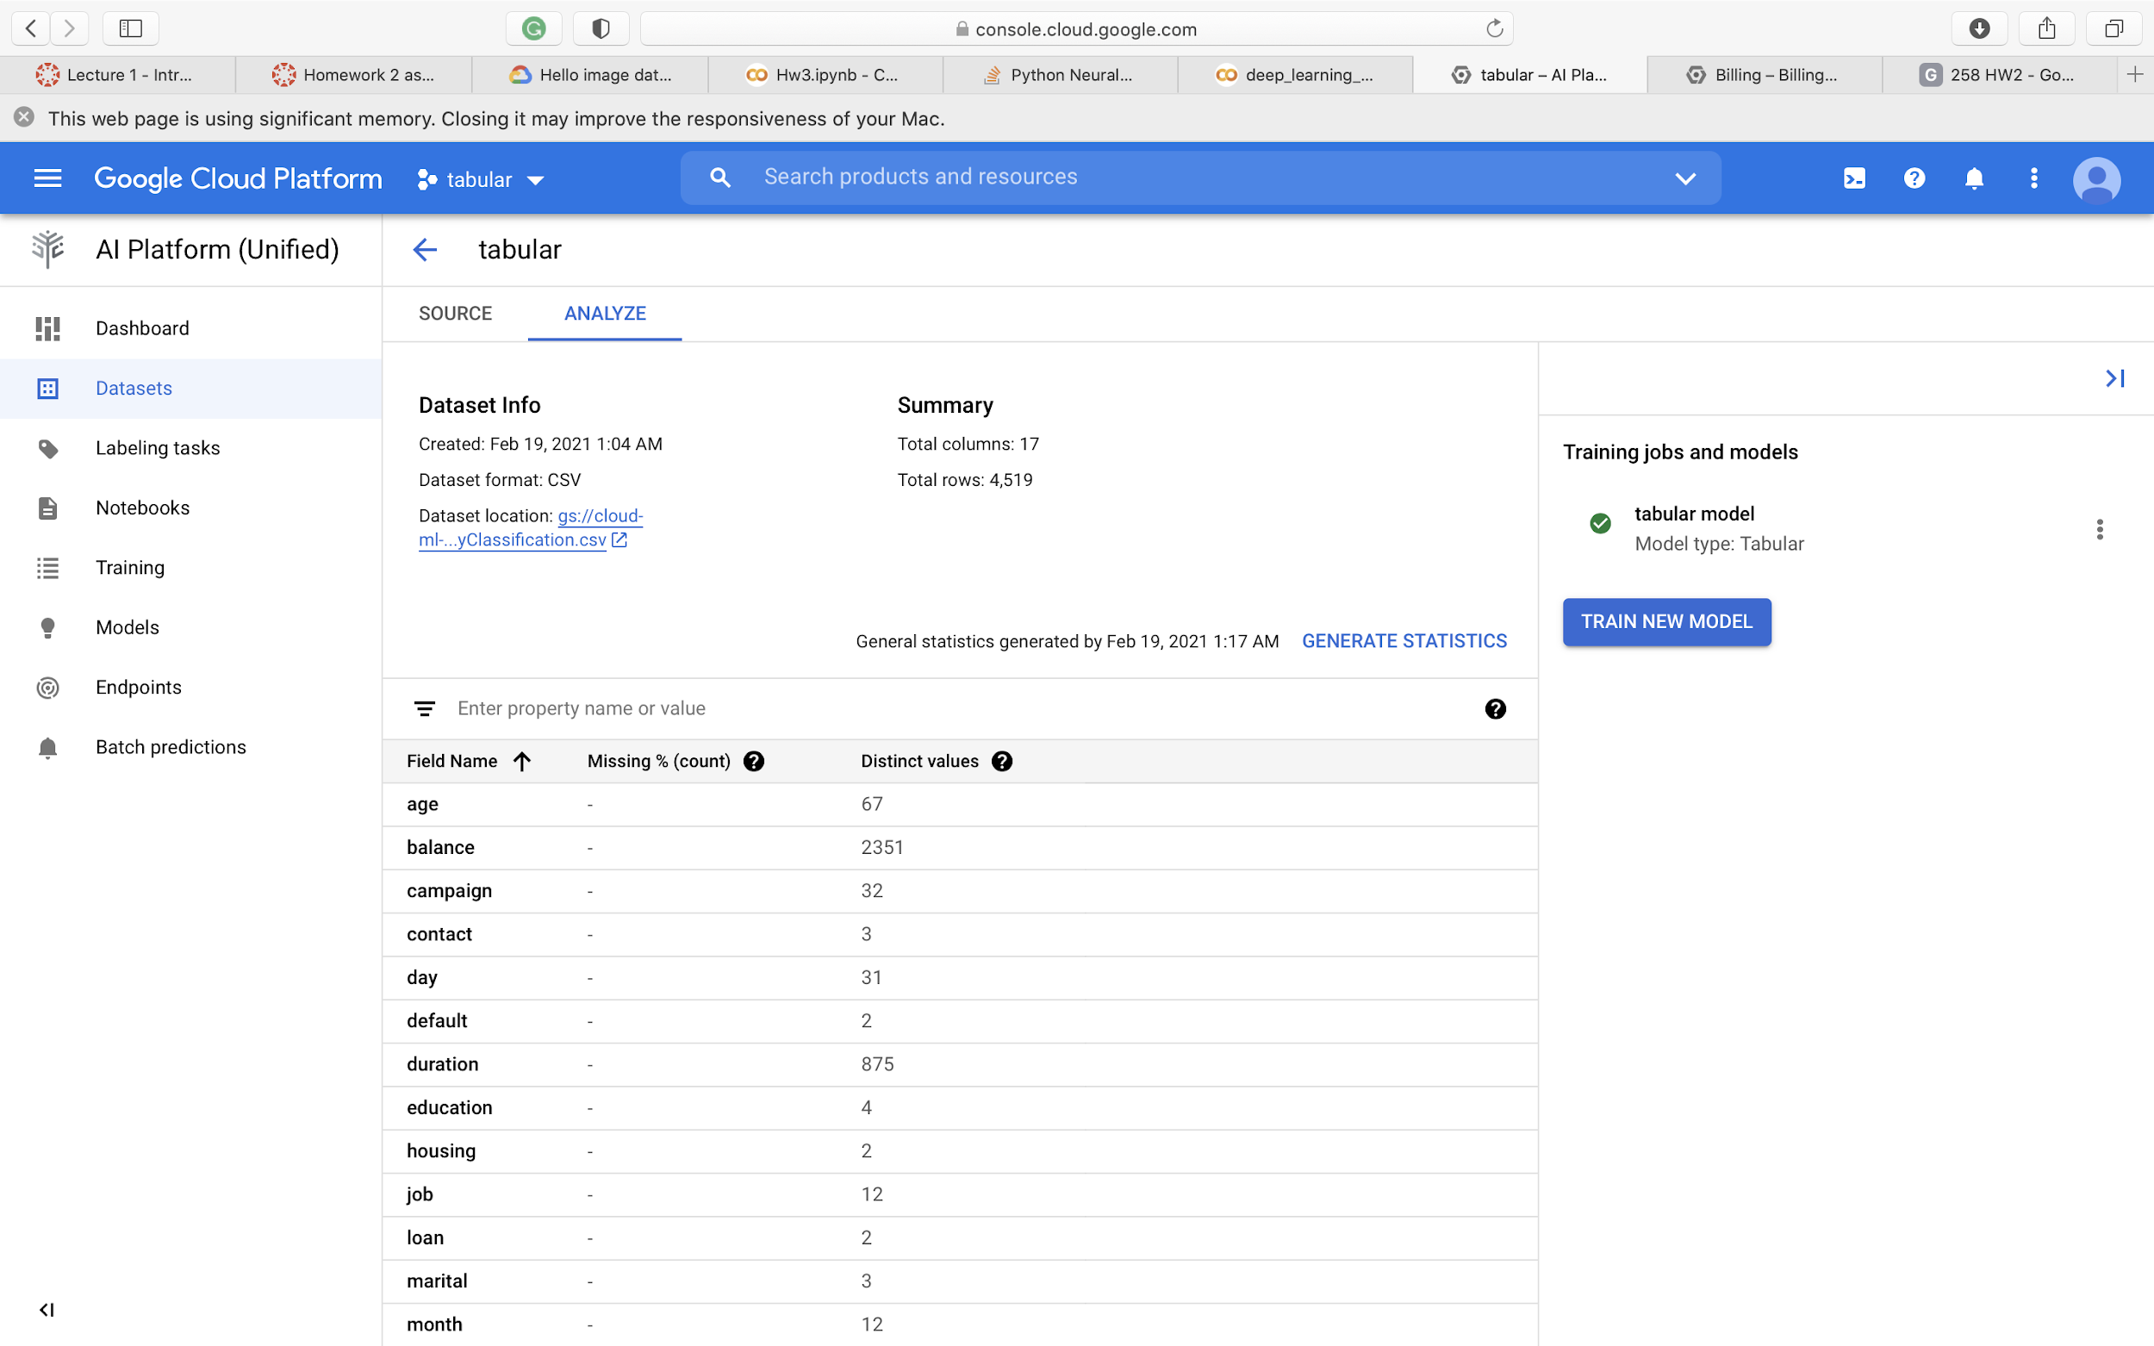

Slide 25
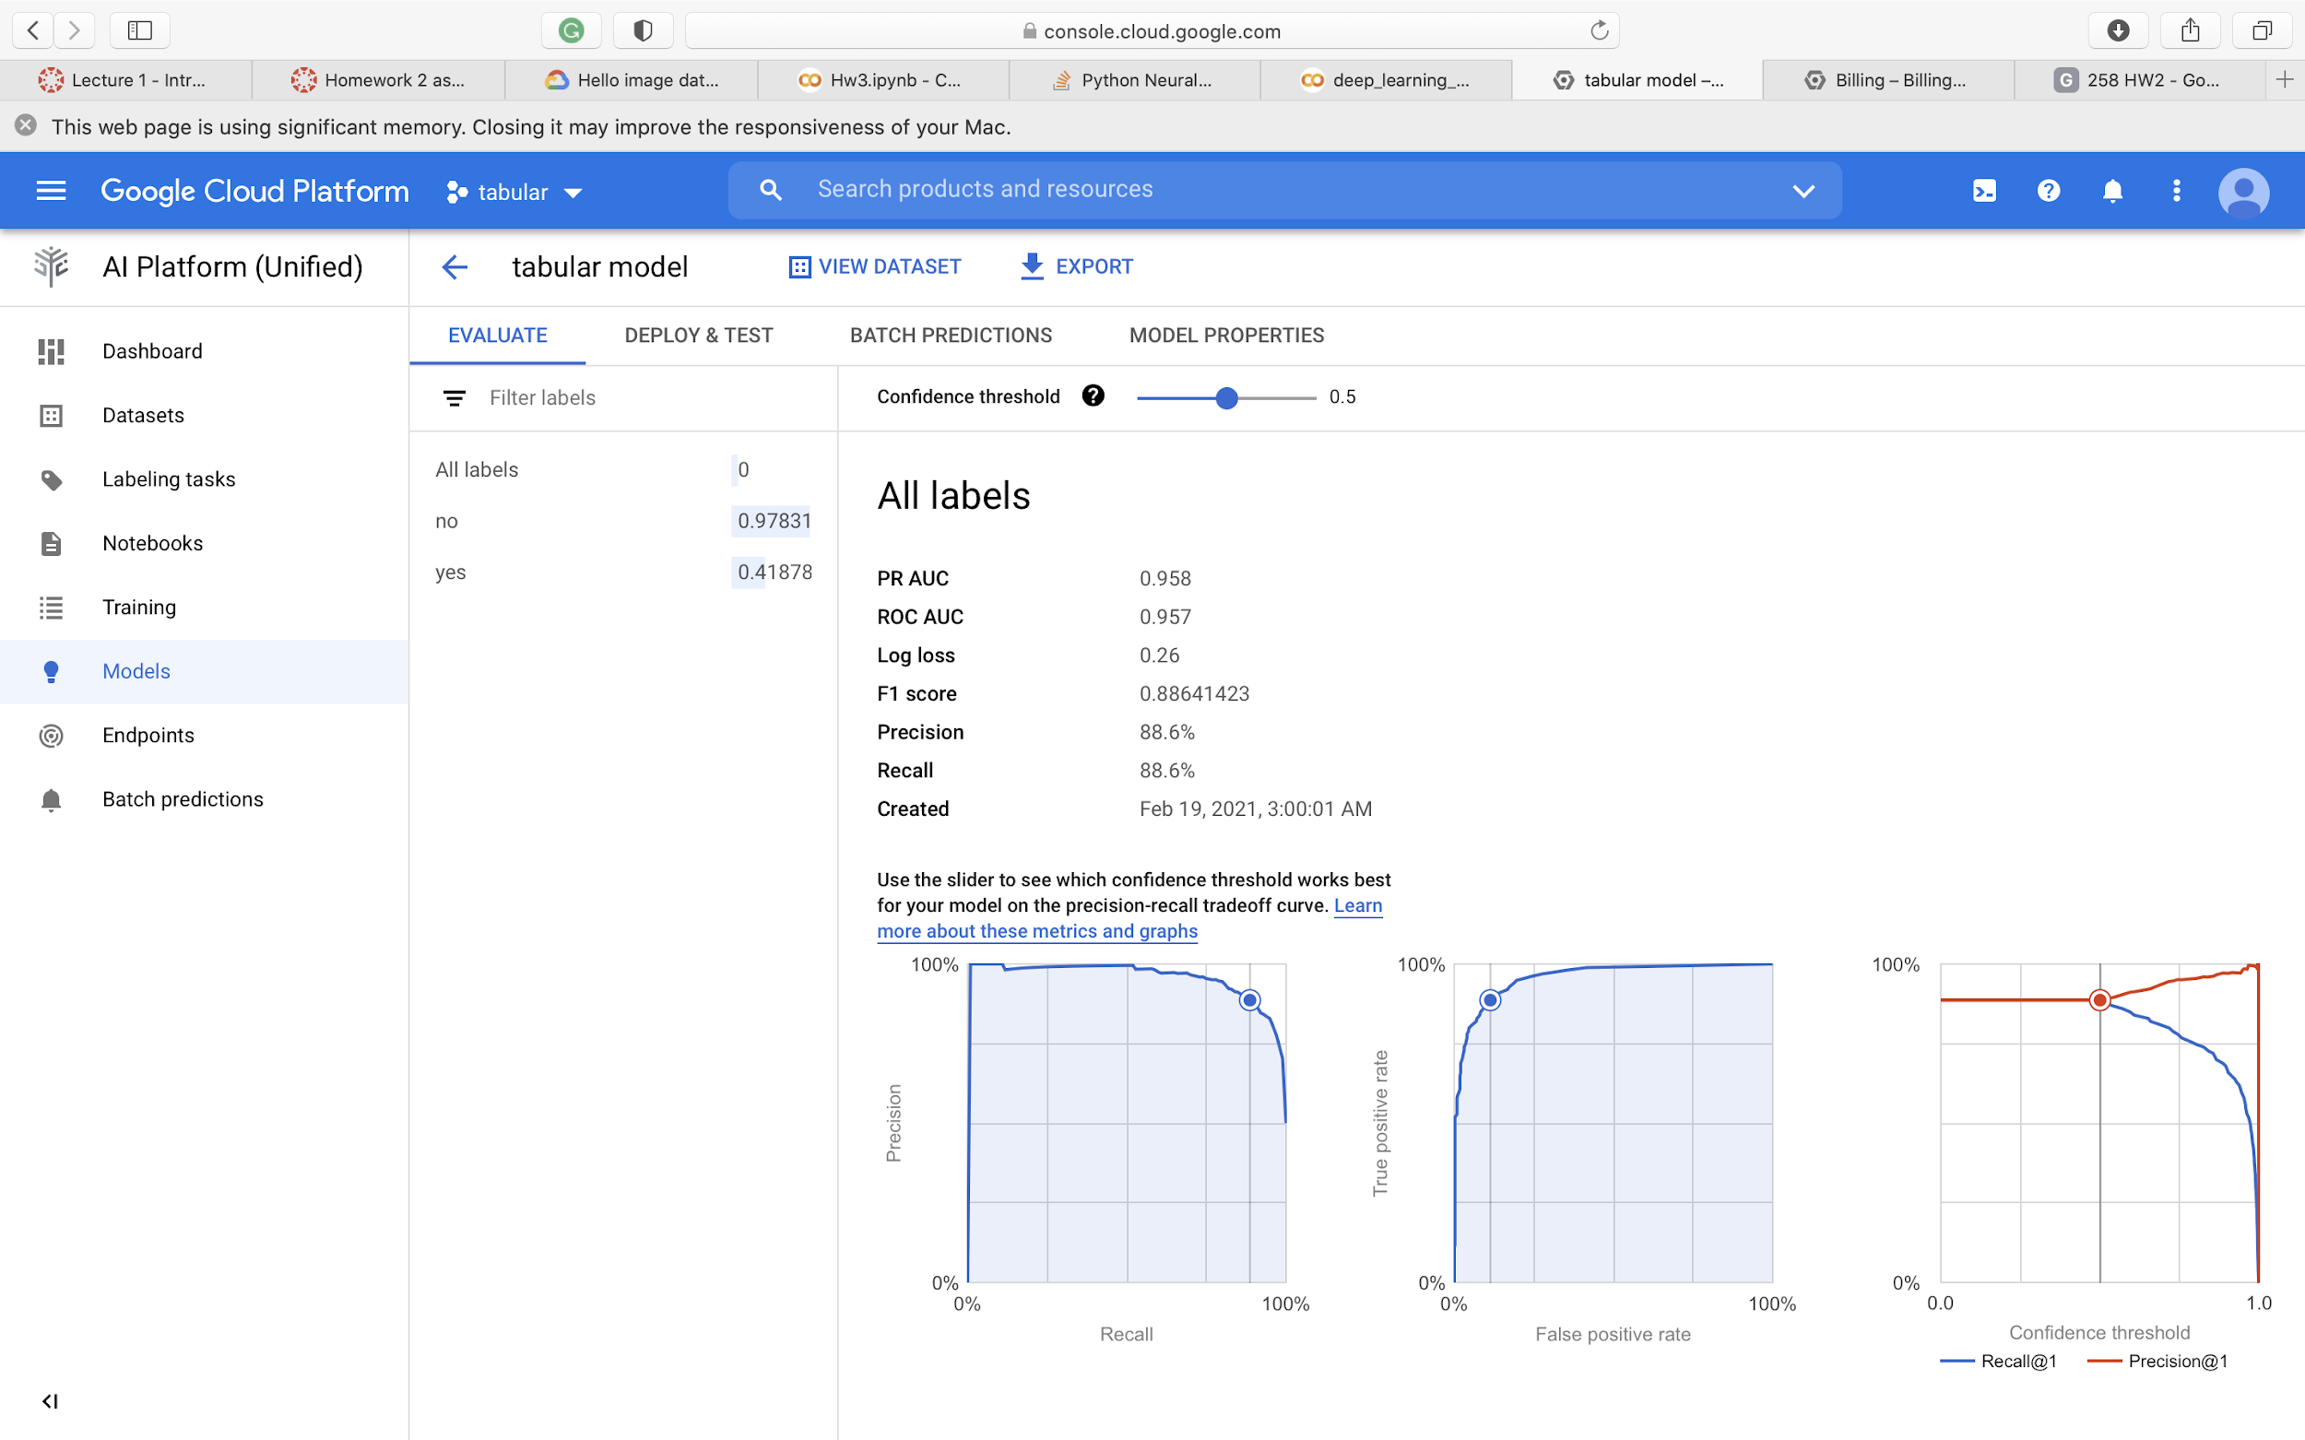

Slide 26
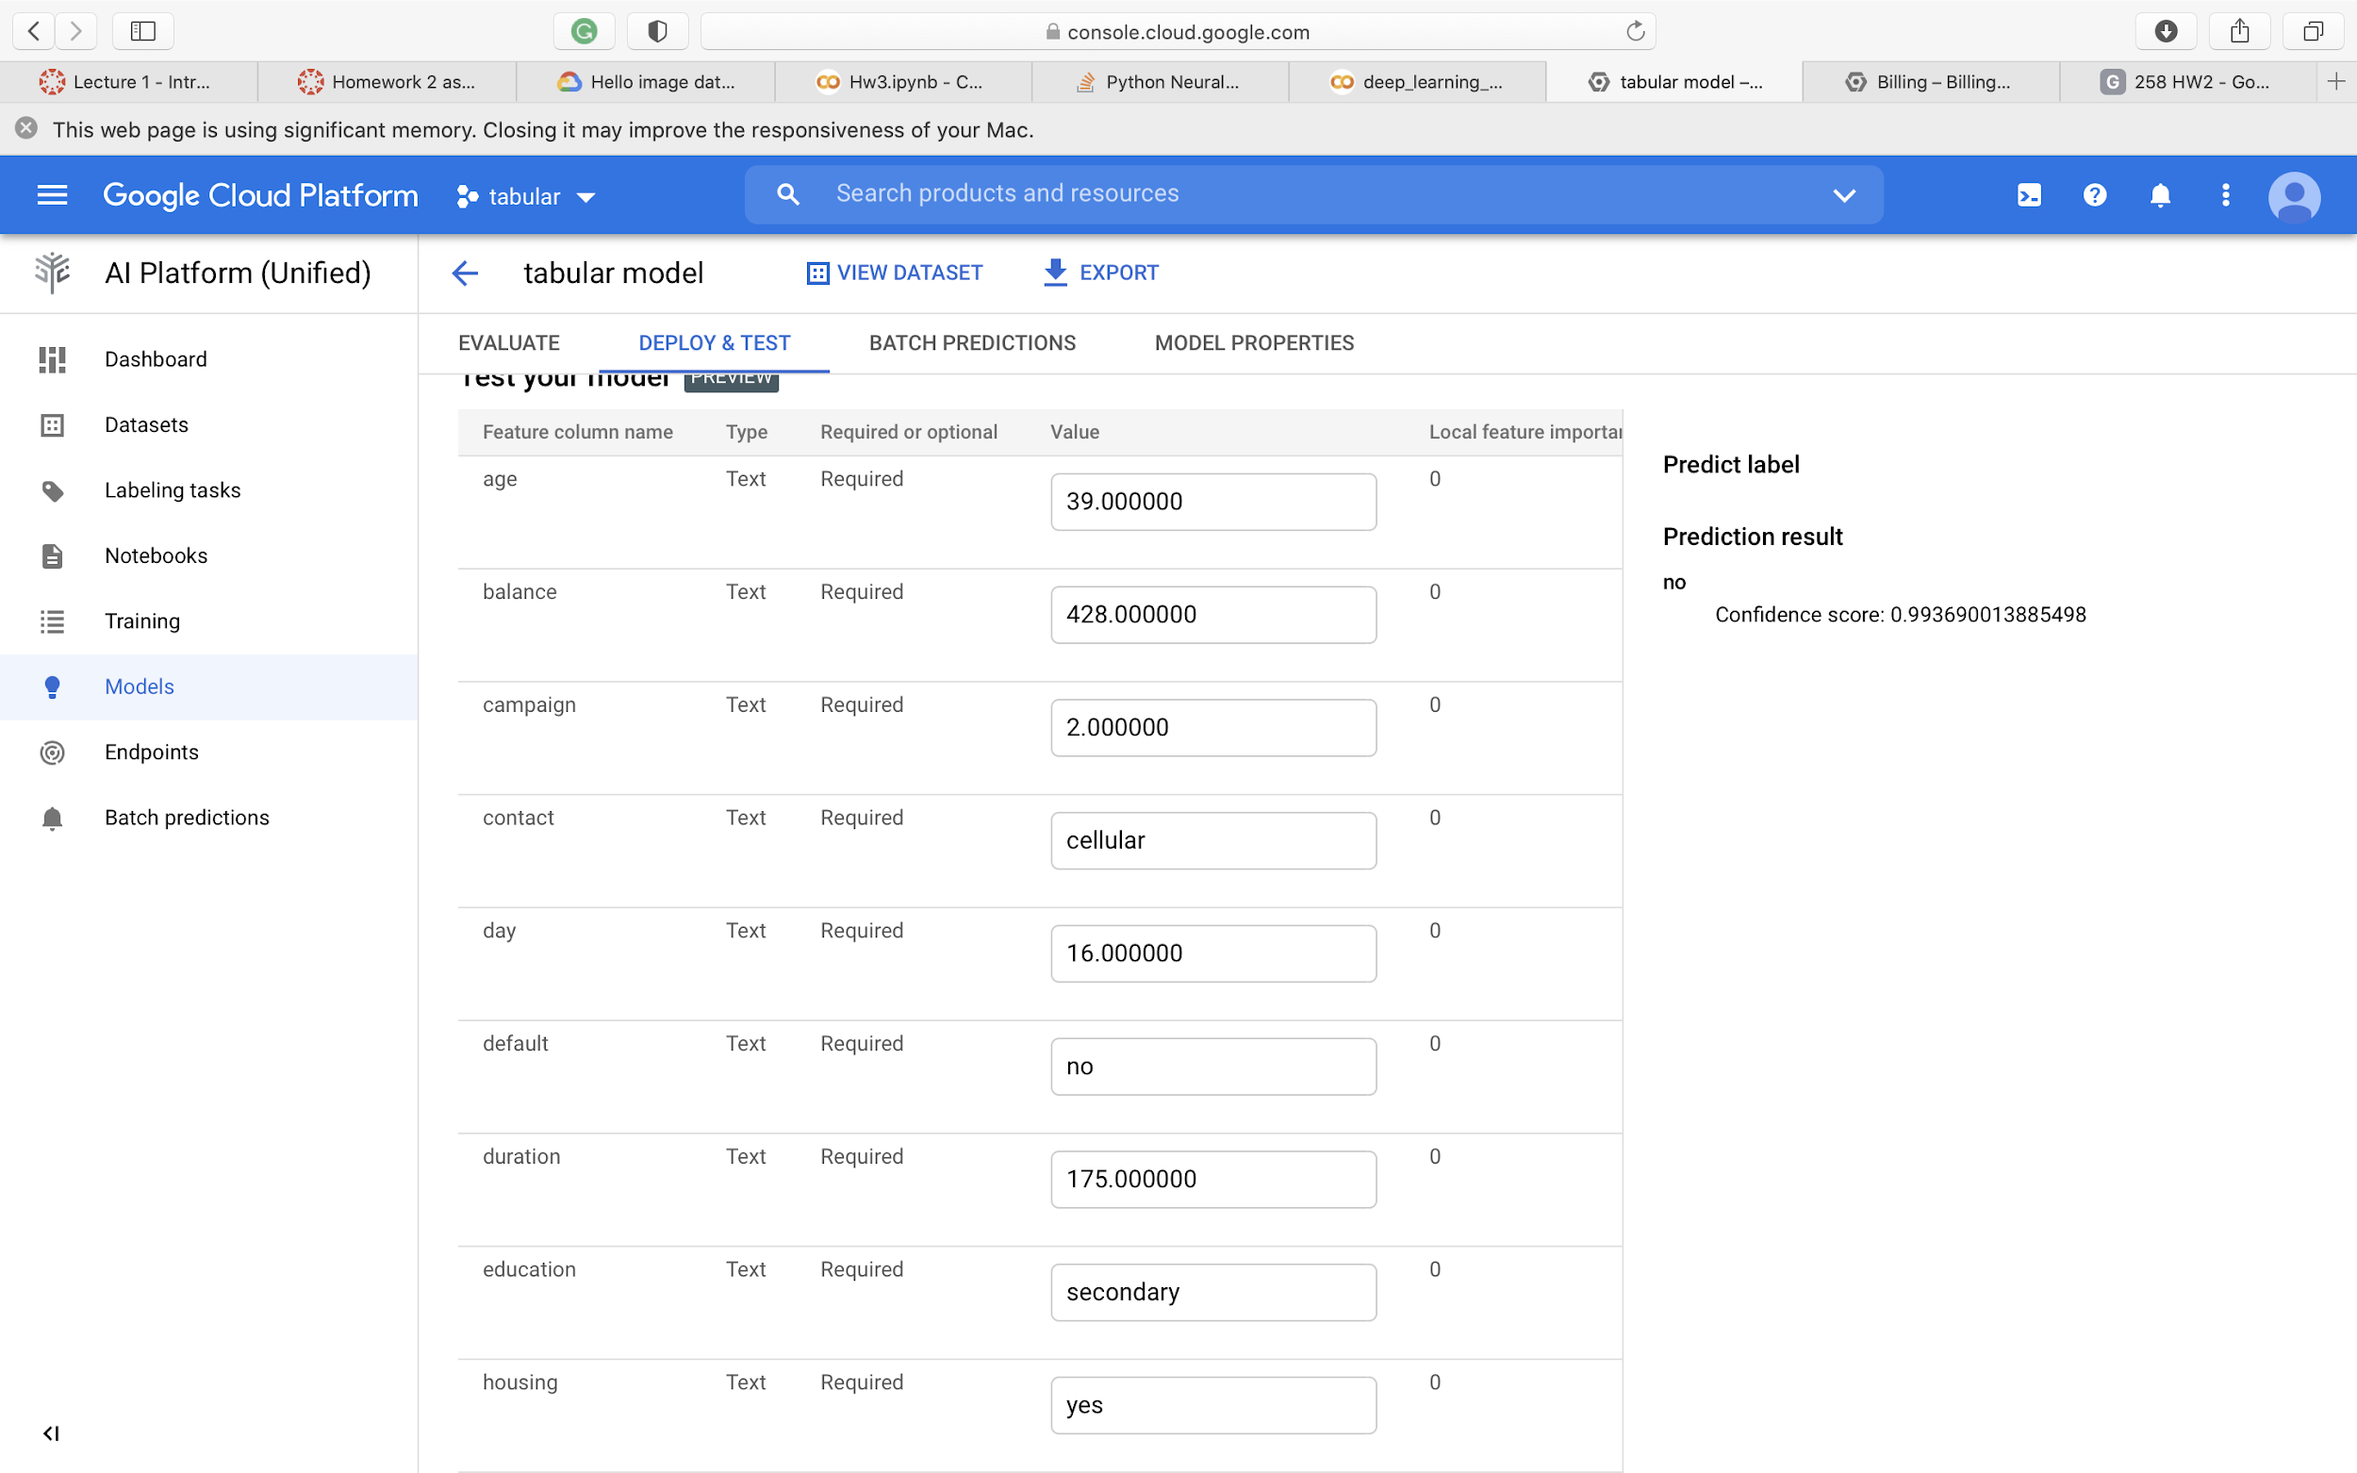

Slide 28
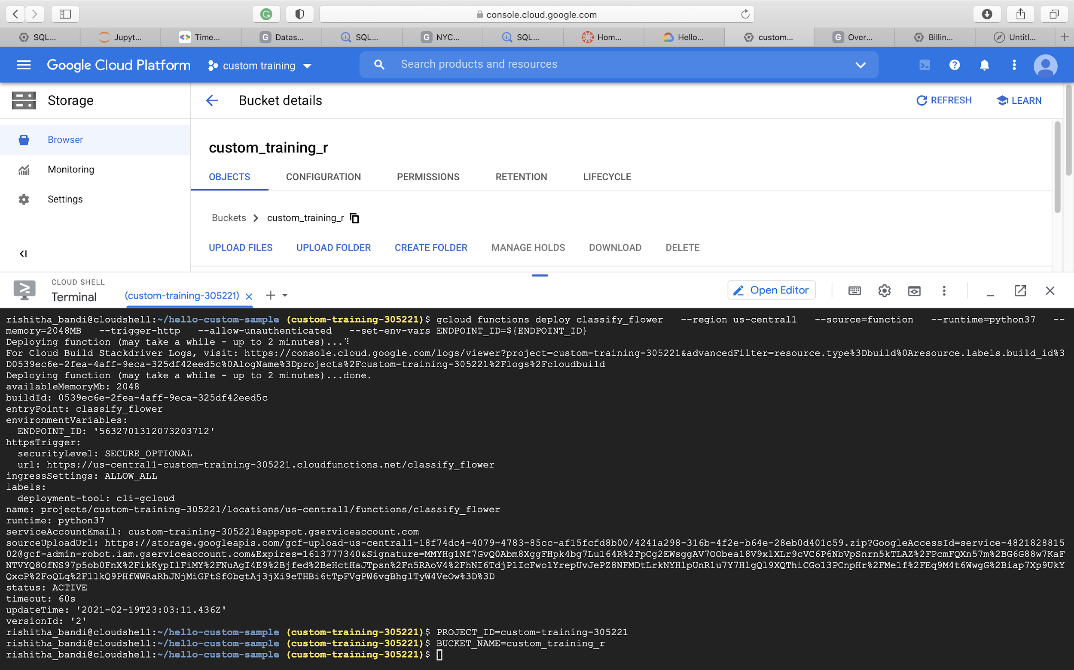
Custom training

Slide 29
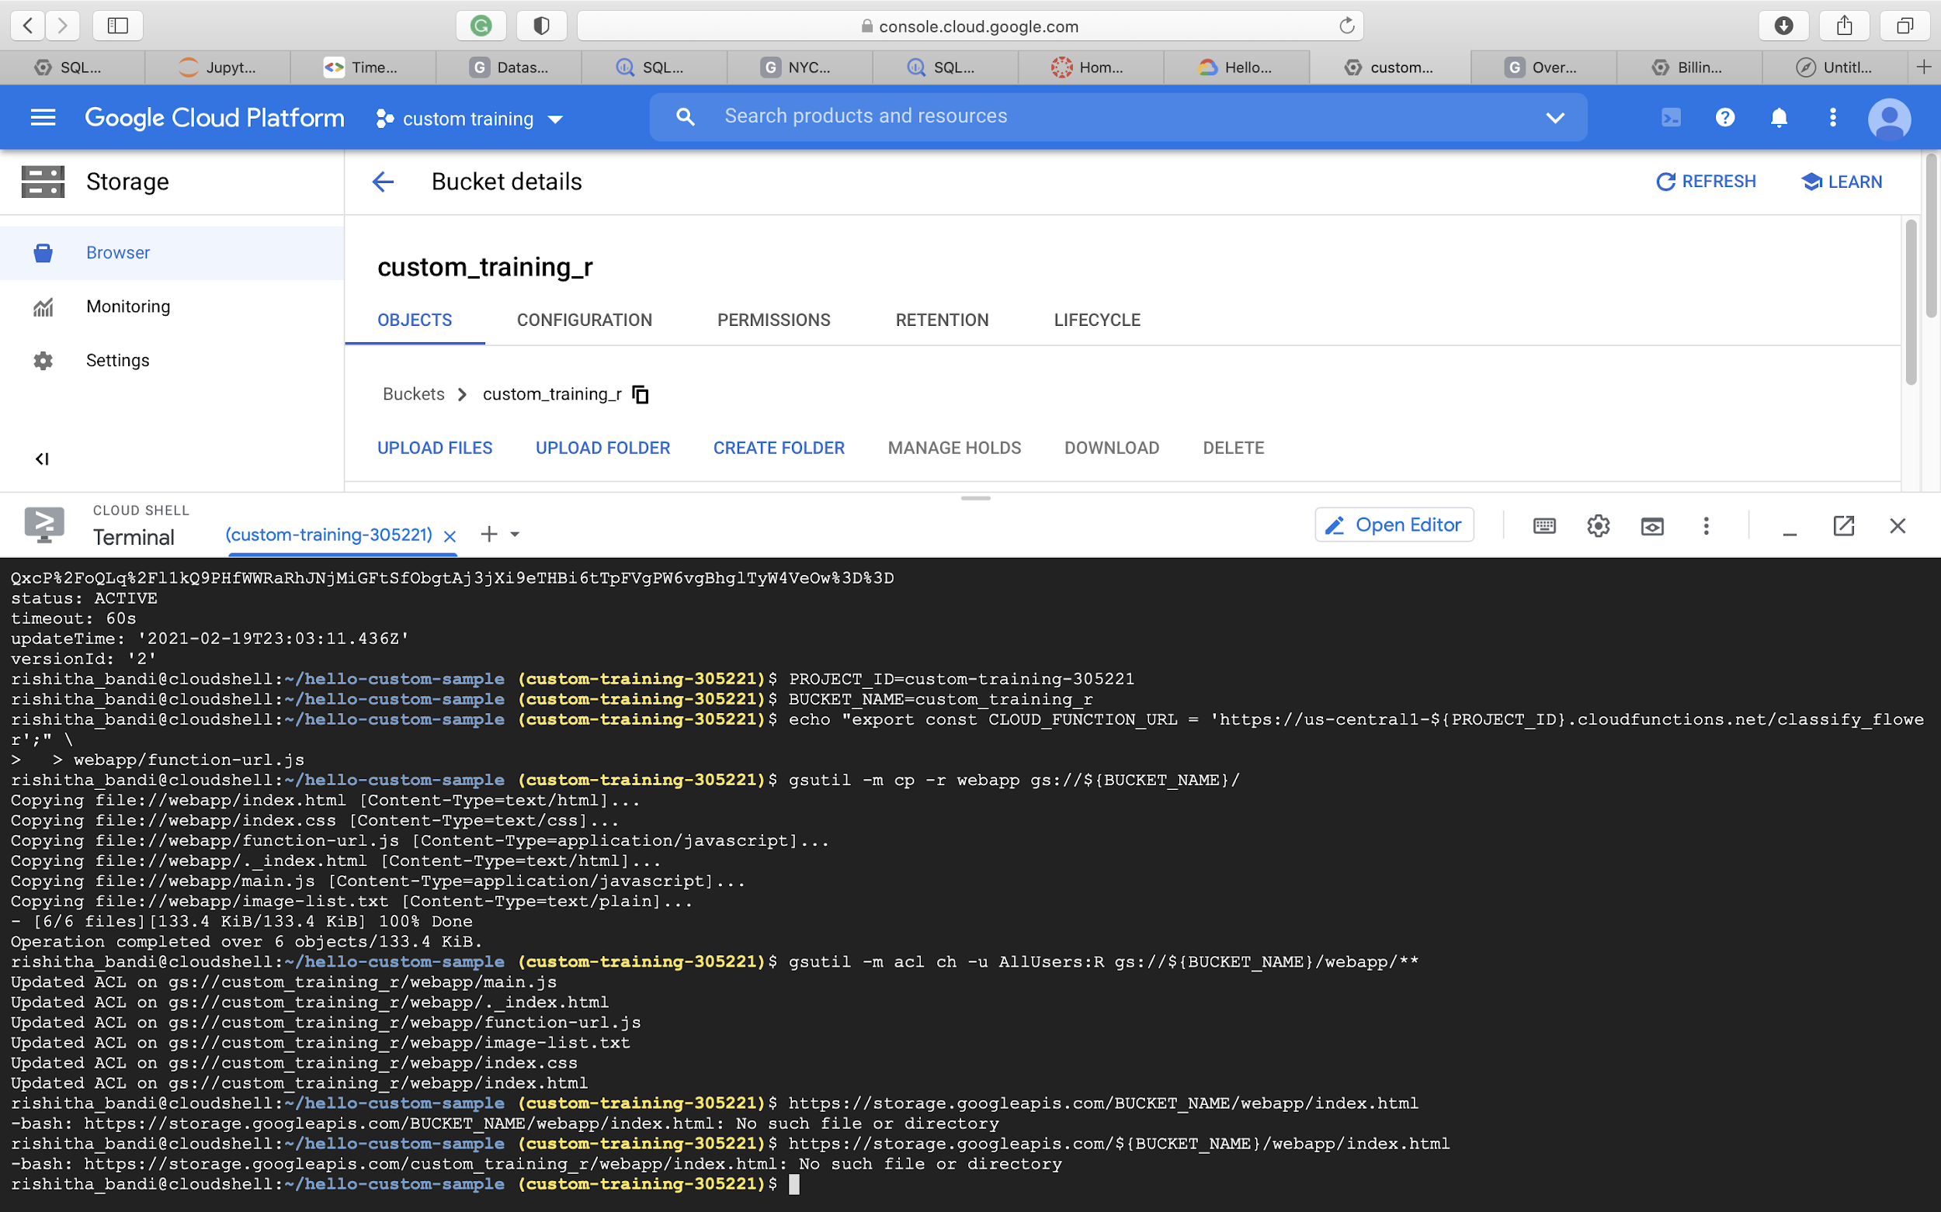

Slide 30
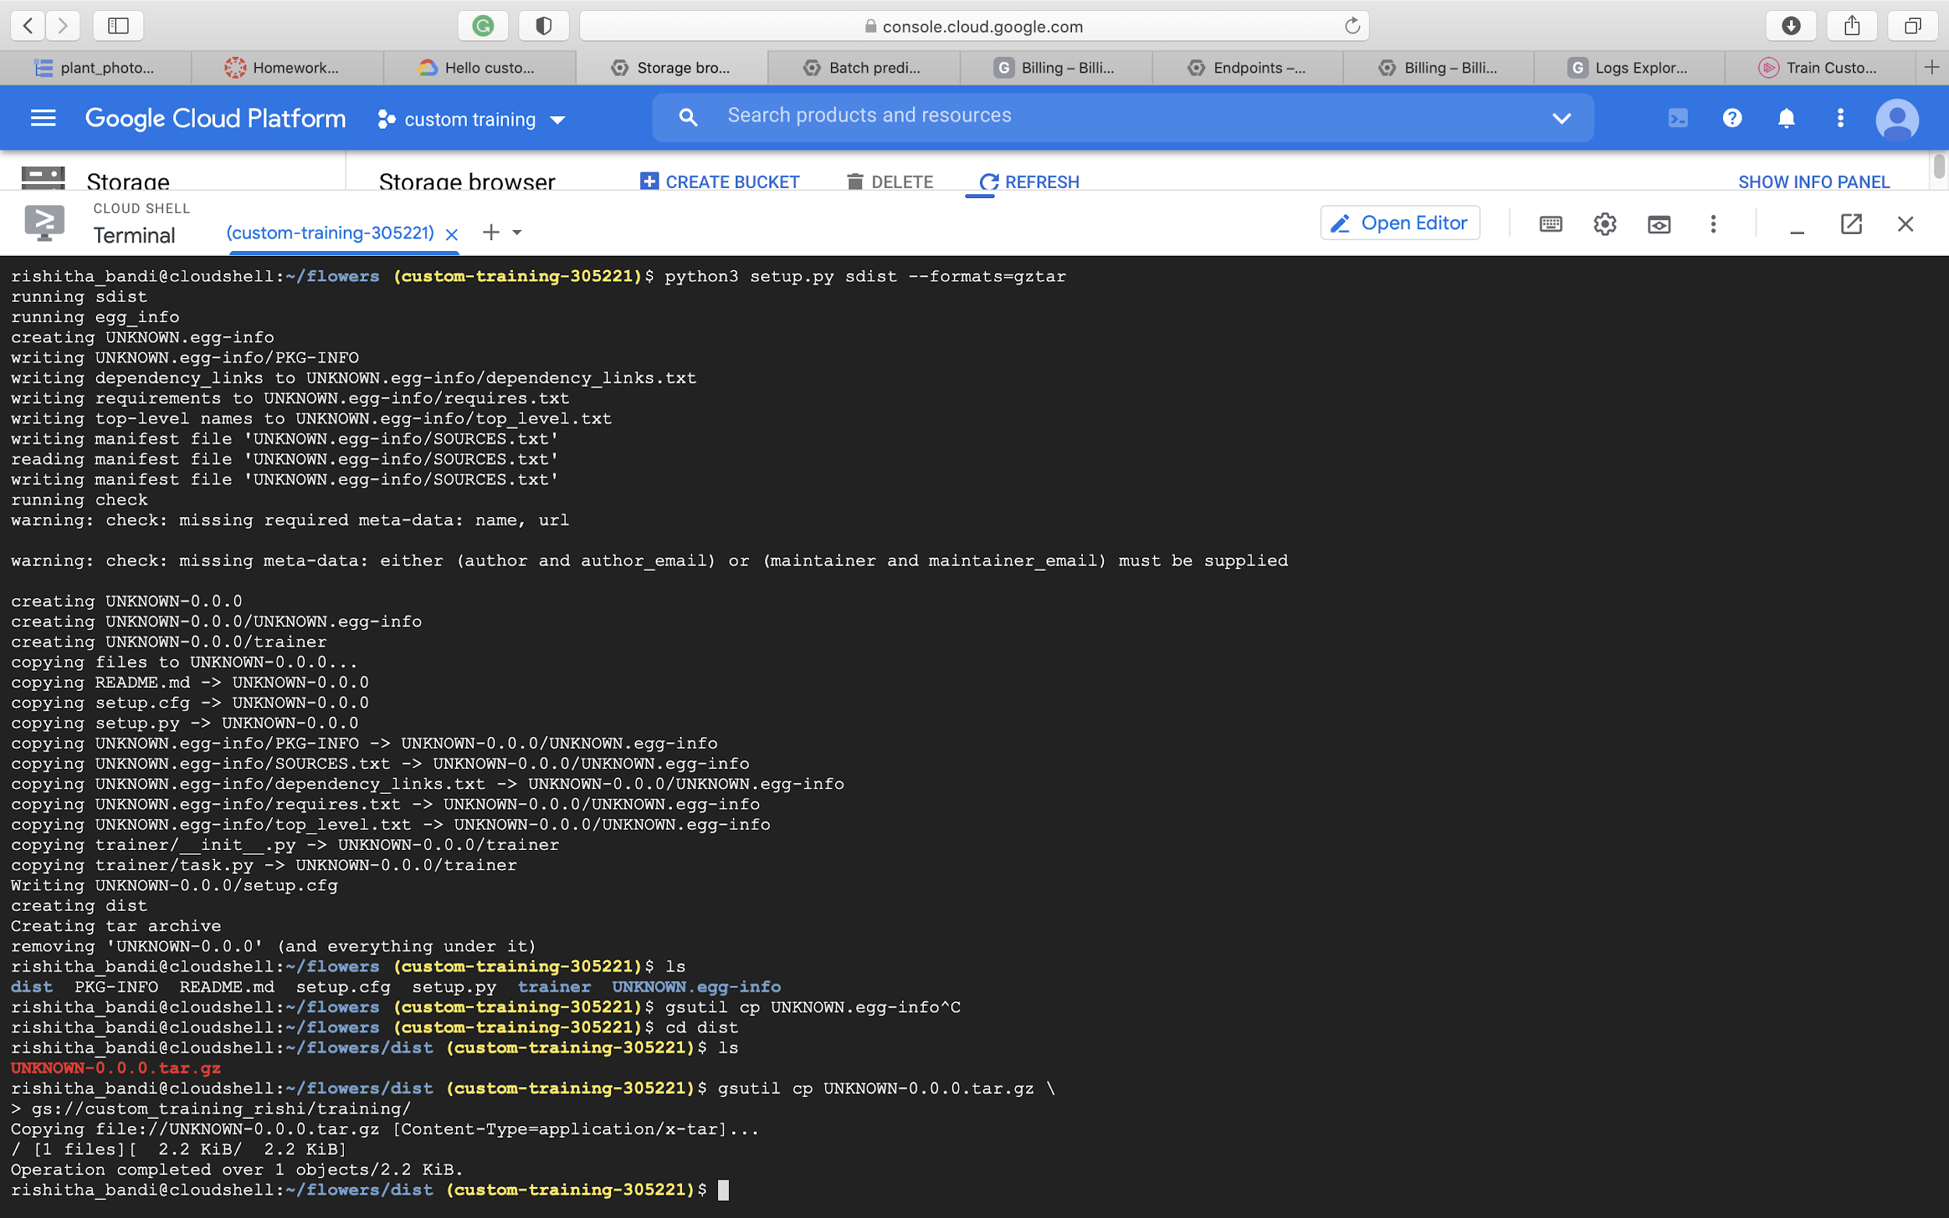

Slide 31
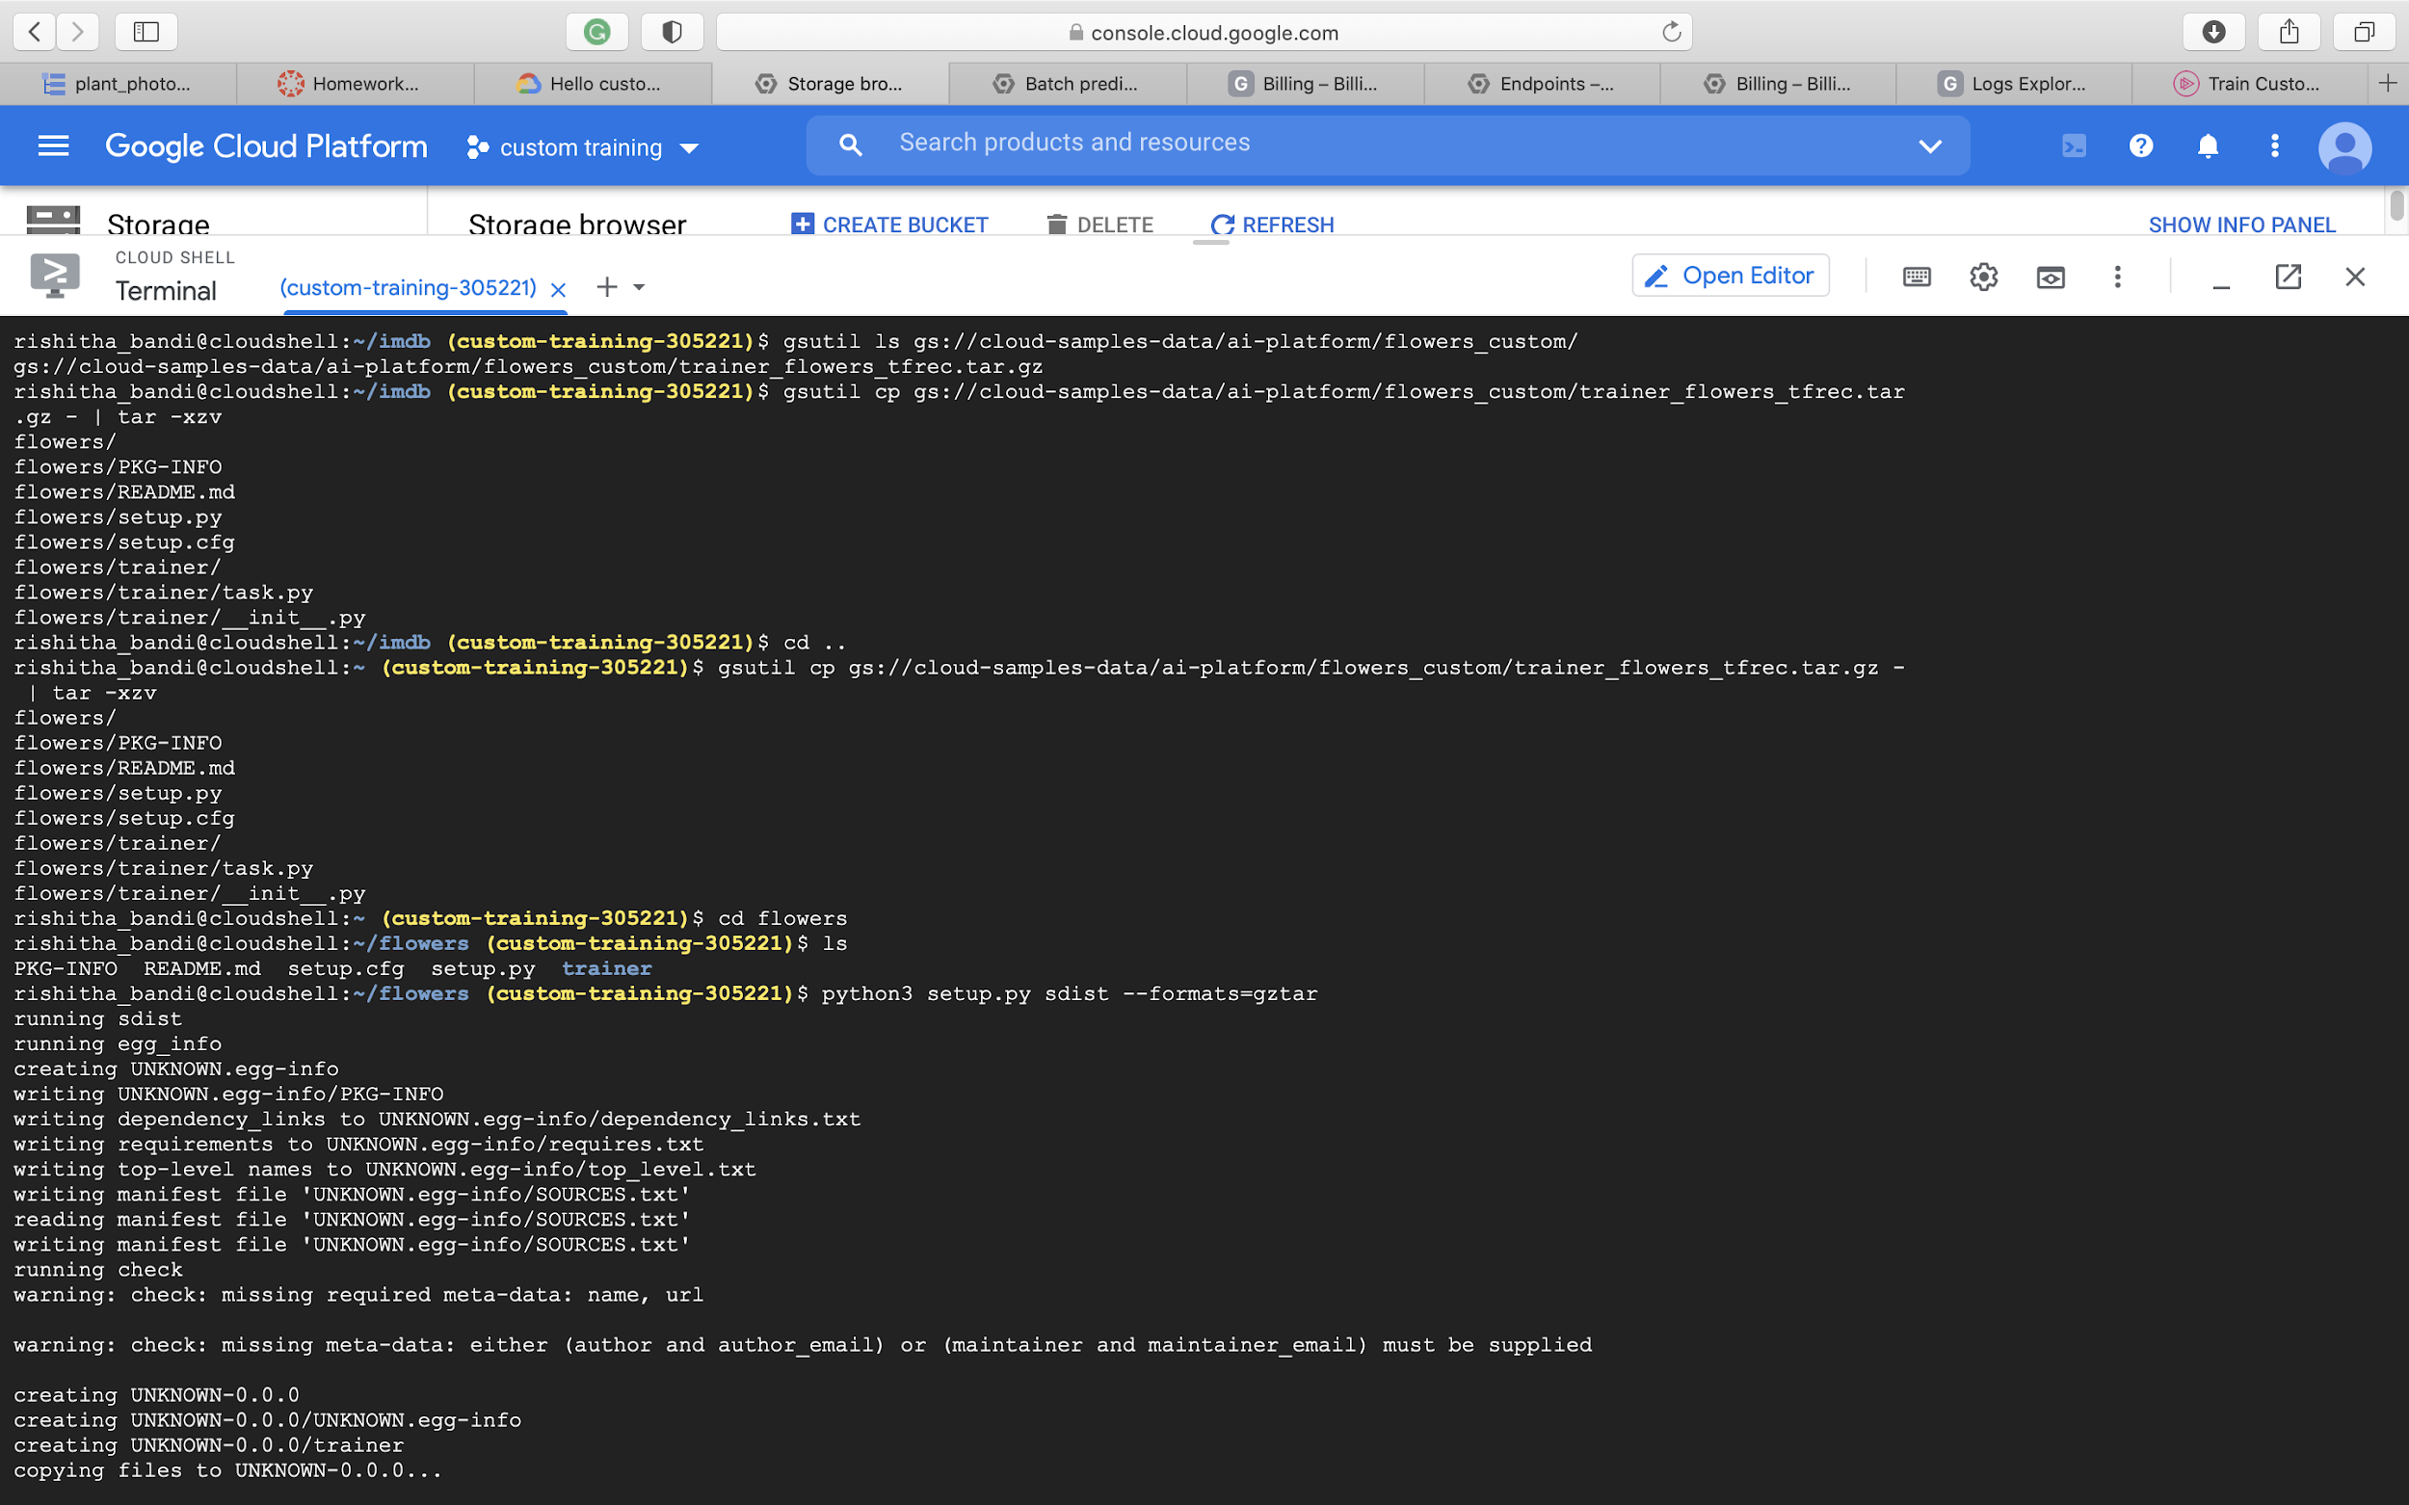

Slide 32
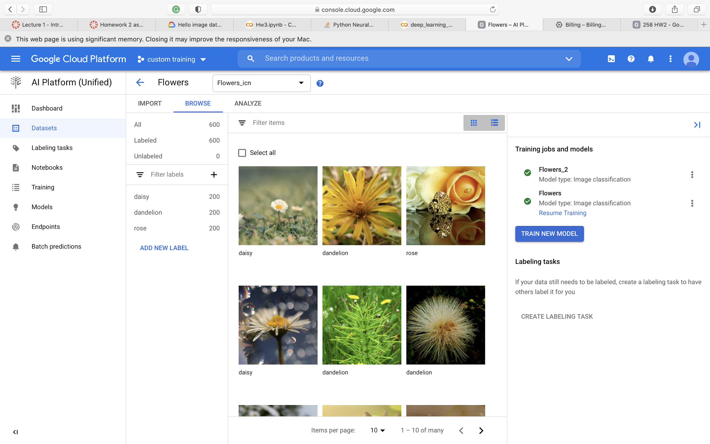

Slide 33
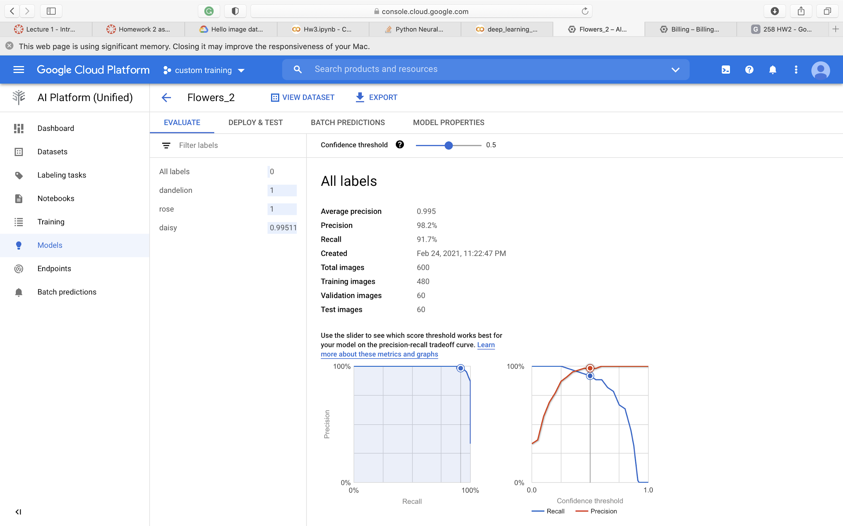

Slide 34
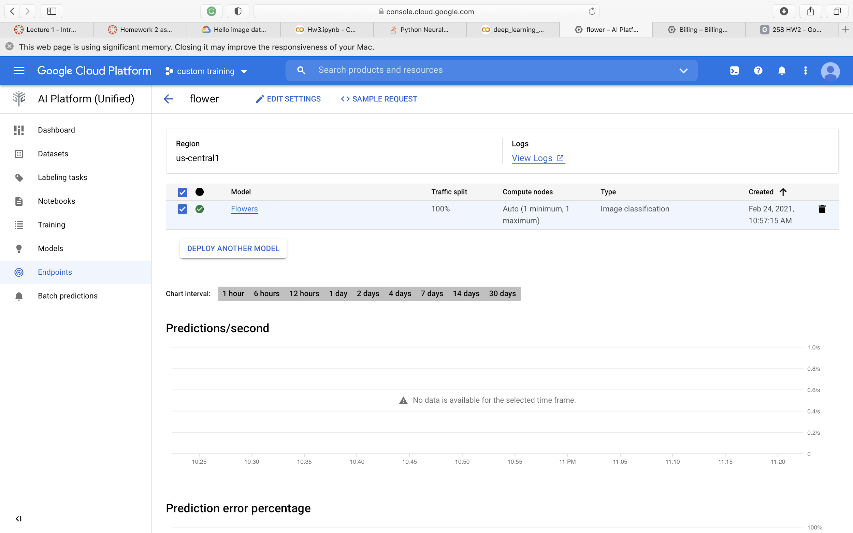

Slide 35
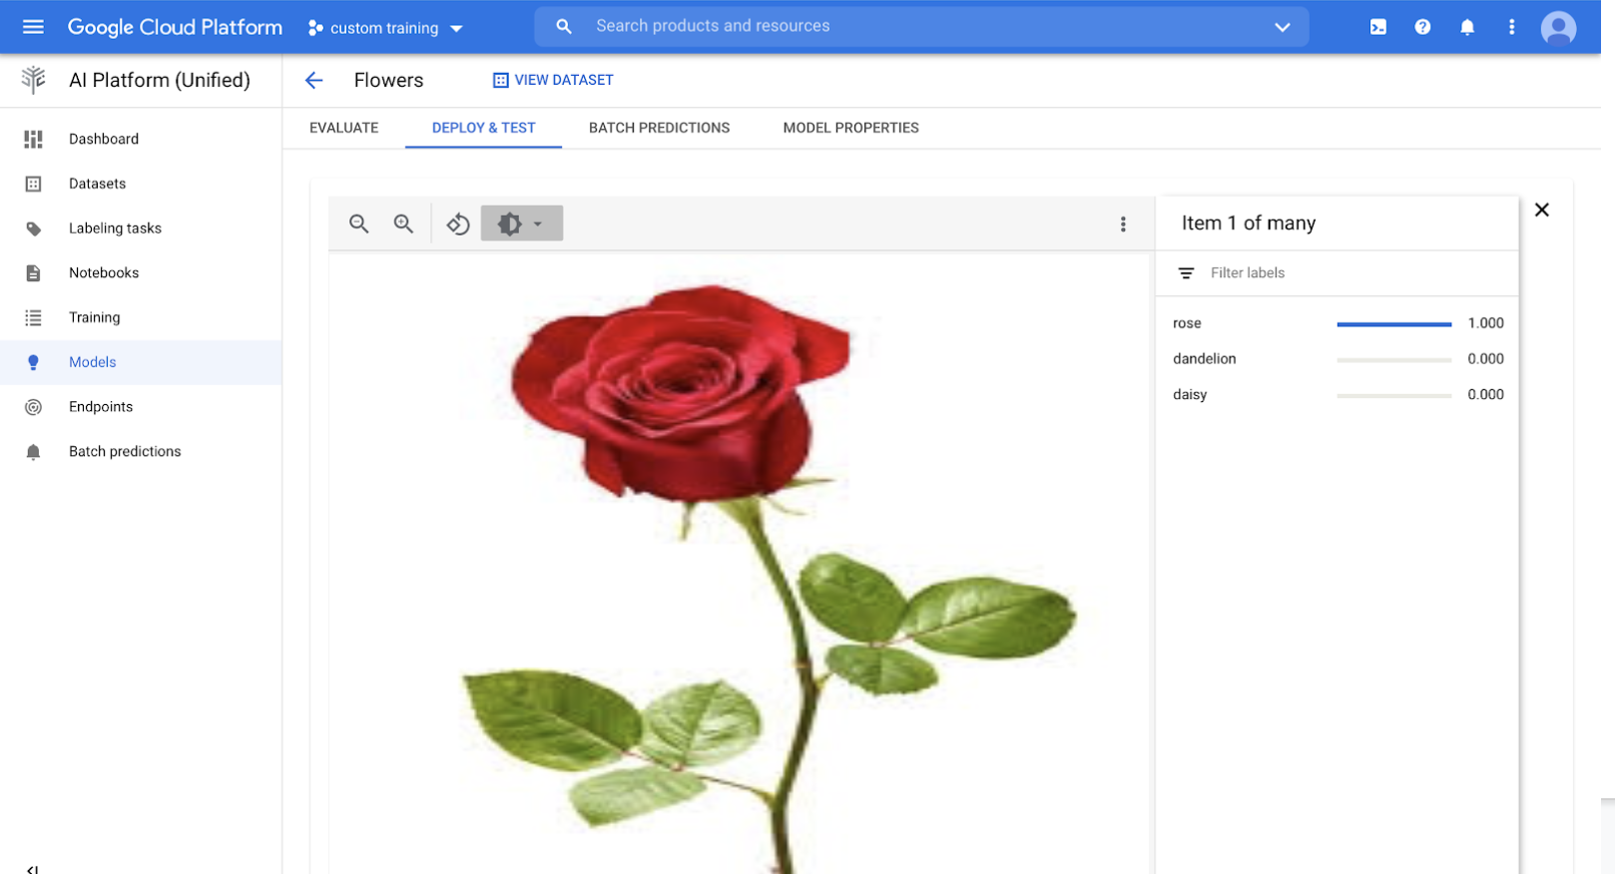

Slide 36
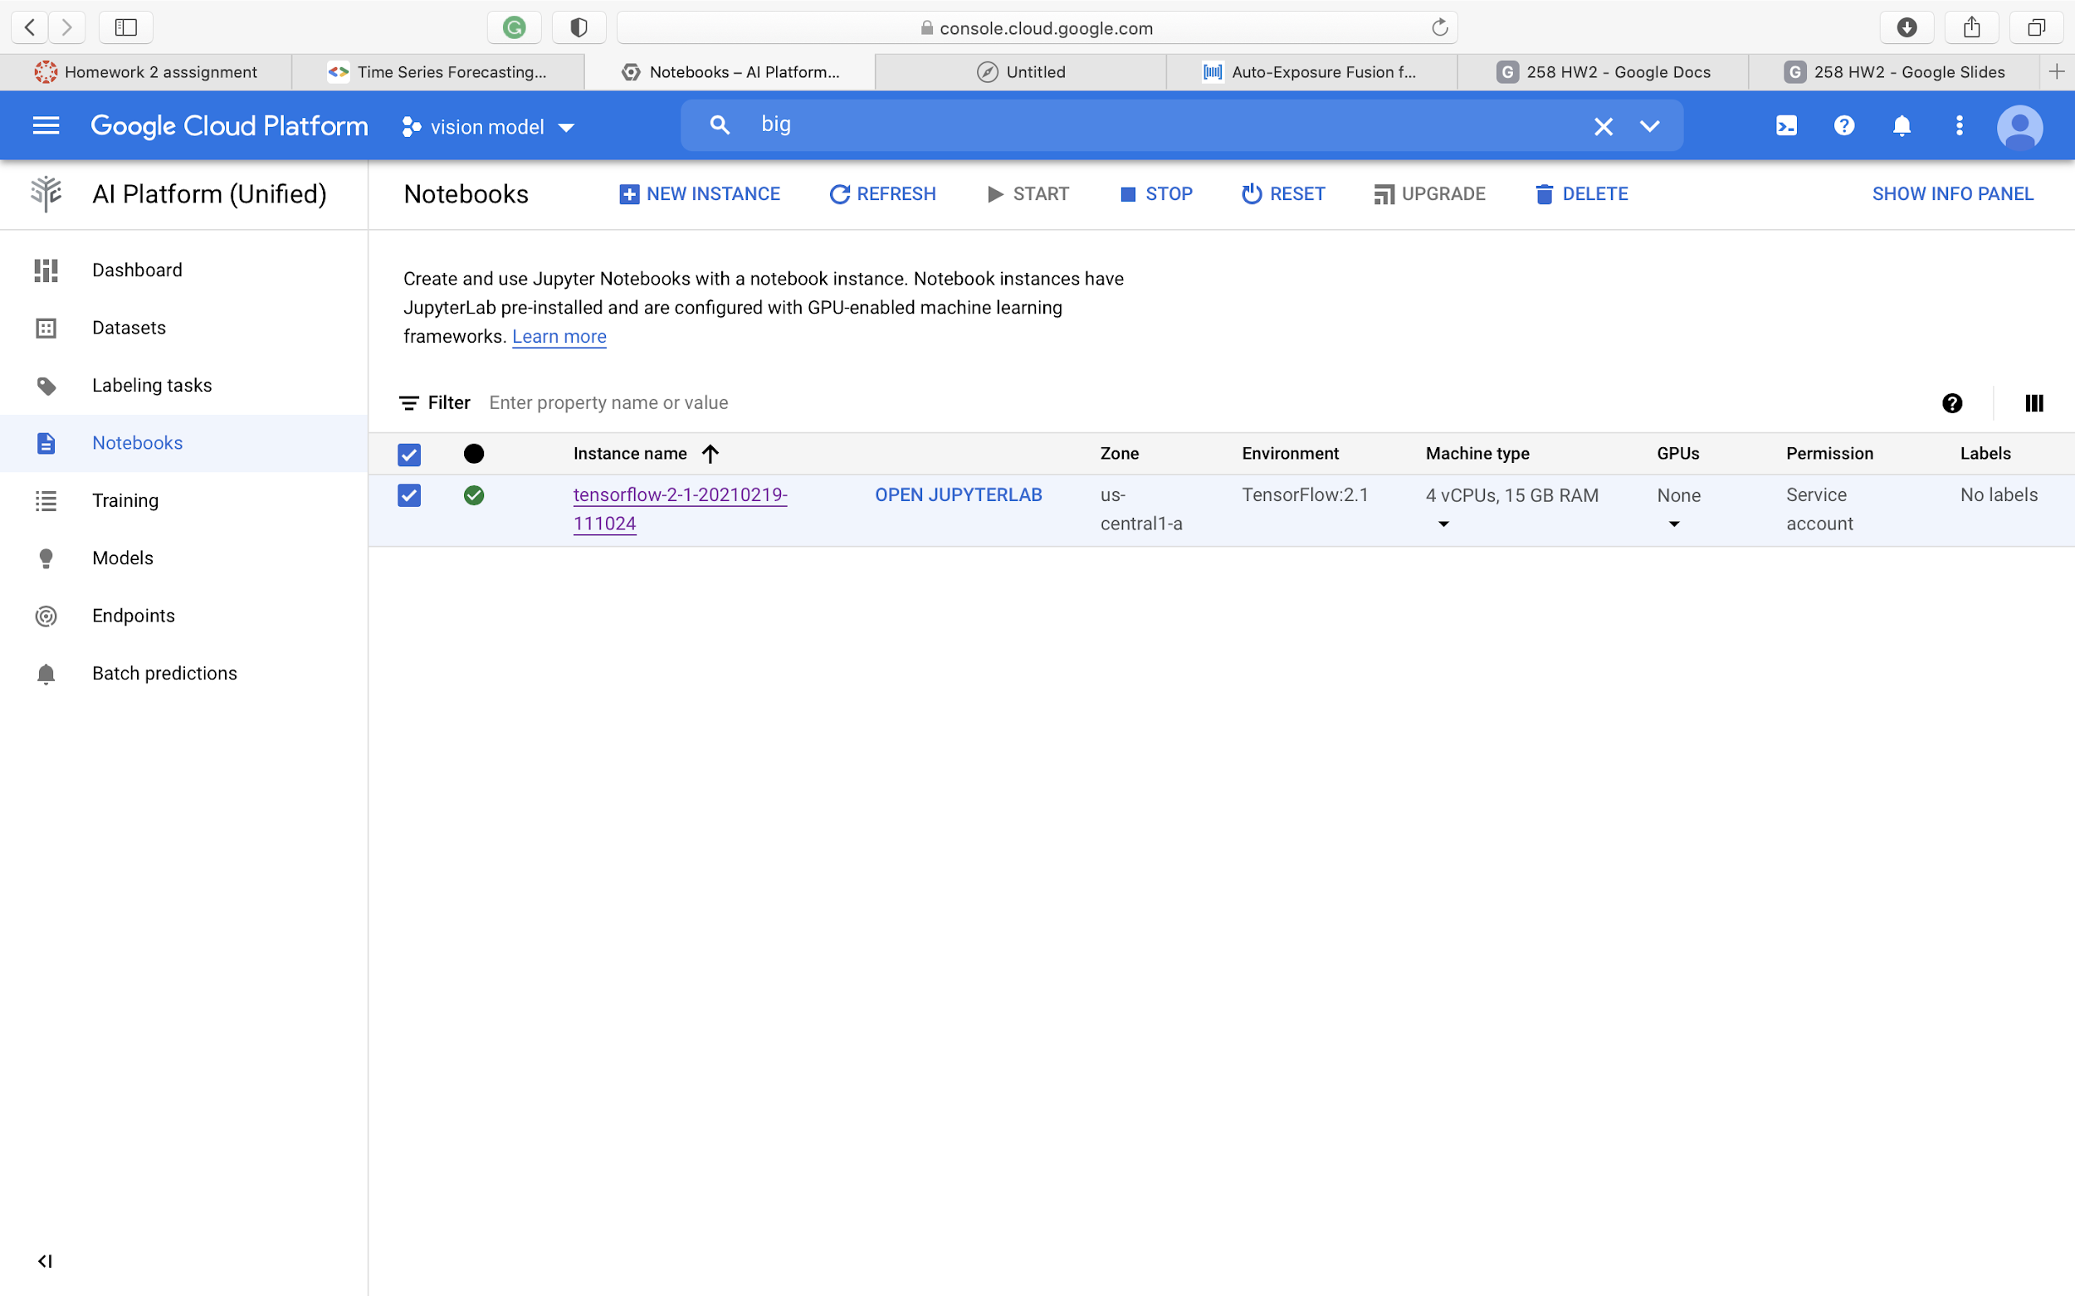
Time series model
Create notebook instance and open jupyter book

Slide 37
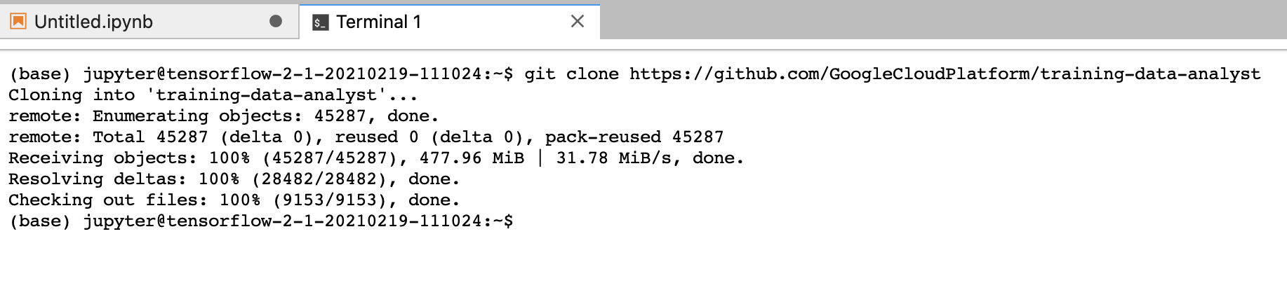
Clone the github repo into notebook

Slide 38
Github link of notebooks
https://github.com/rishitha97/258/tree/main/timeseries%20vision%20model

Slide 39
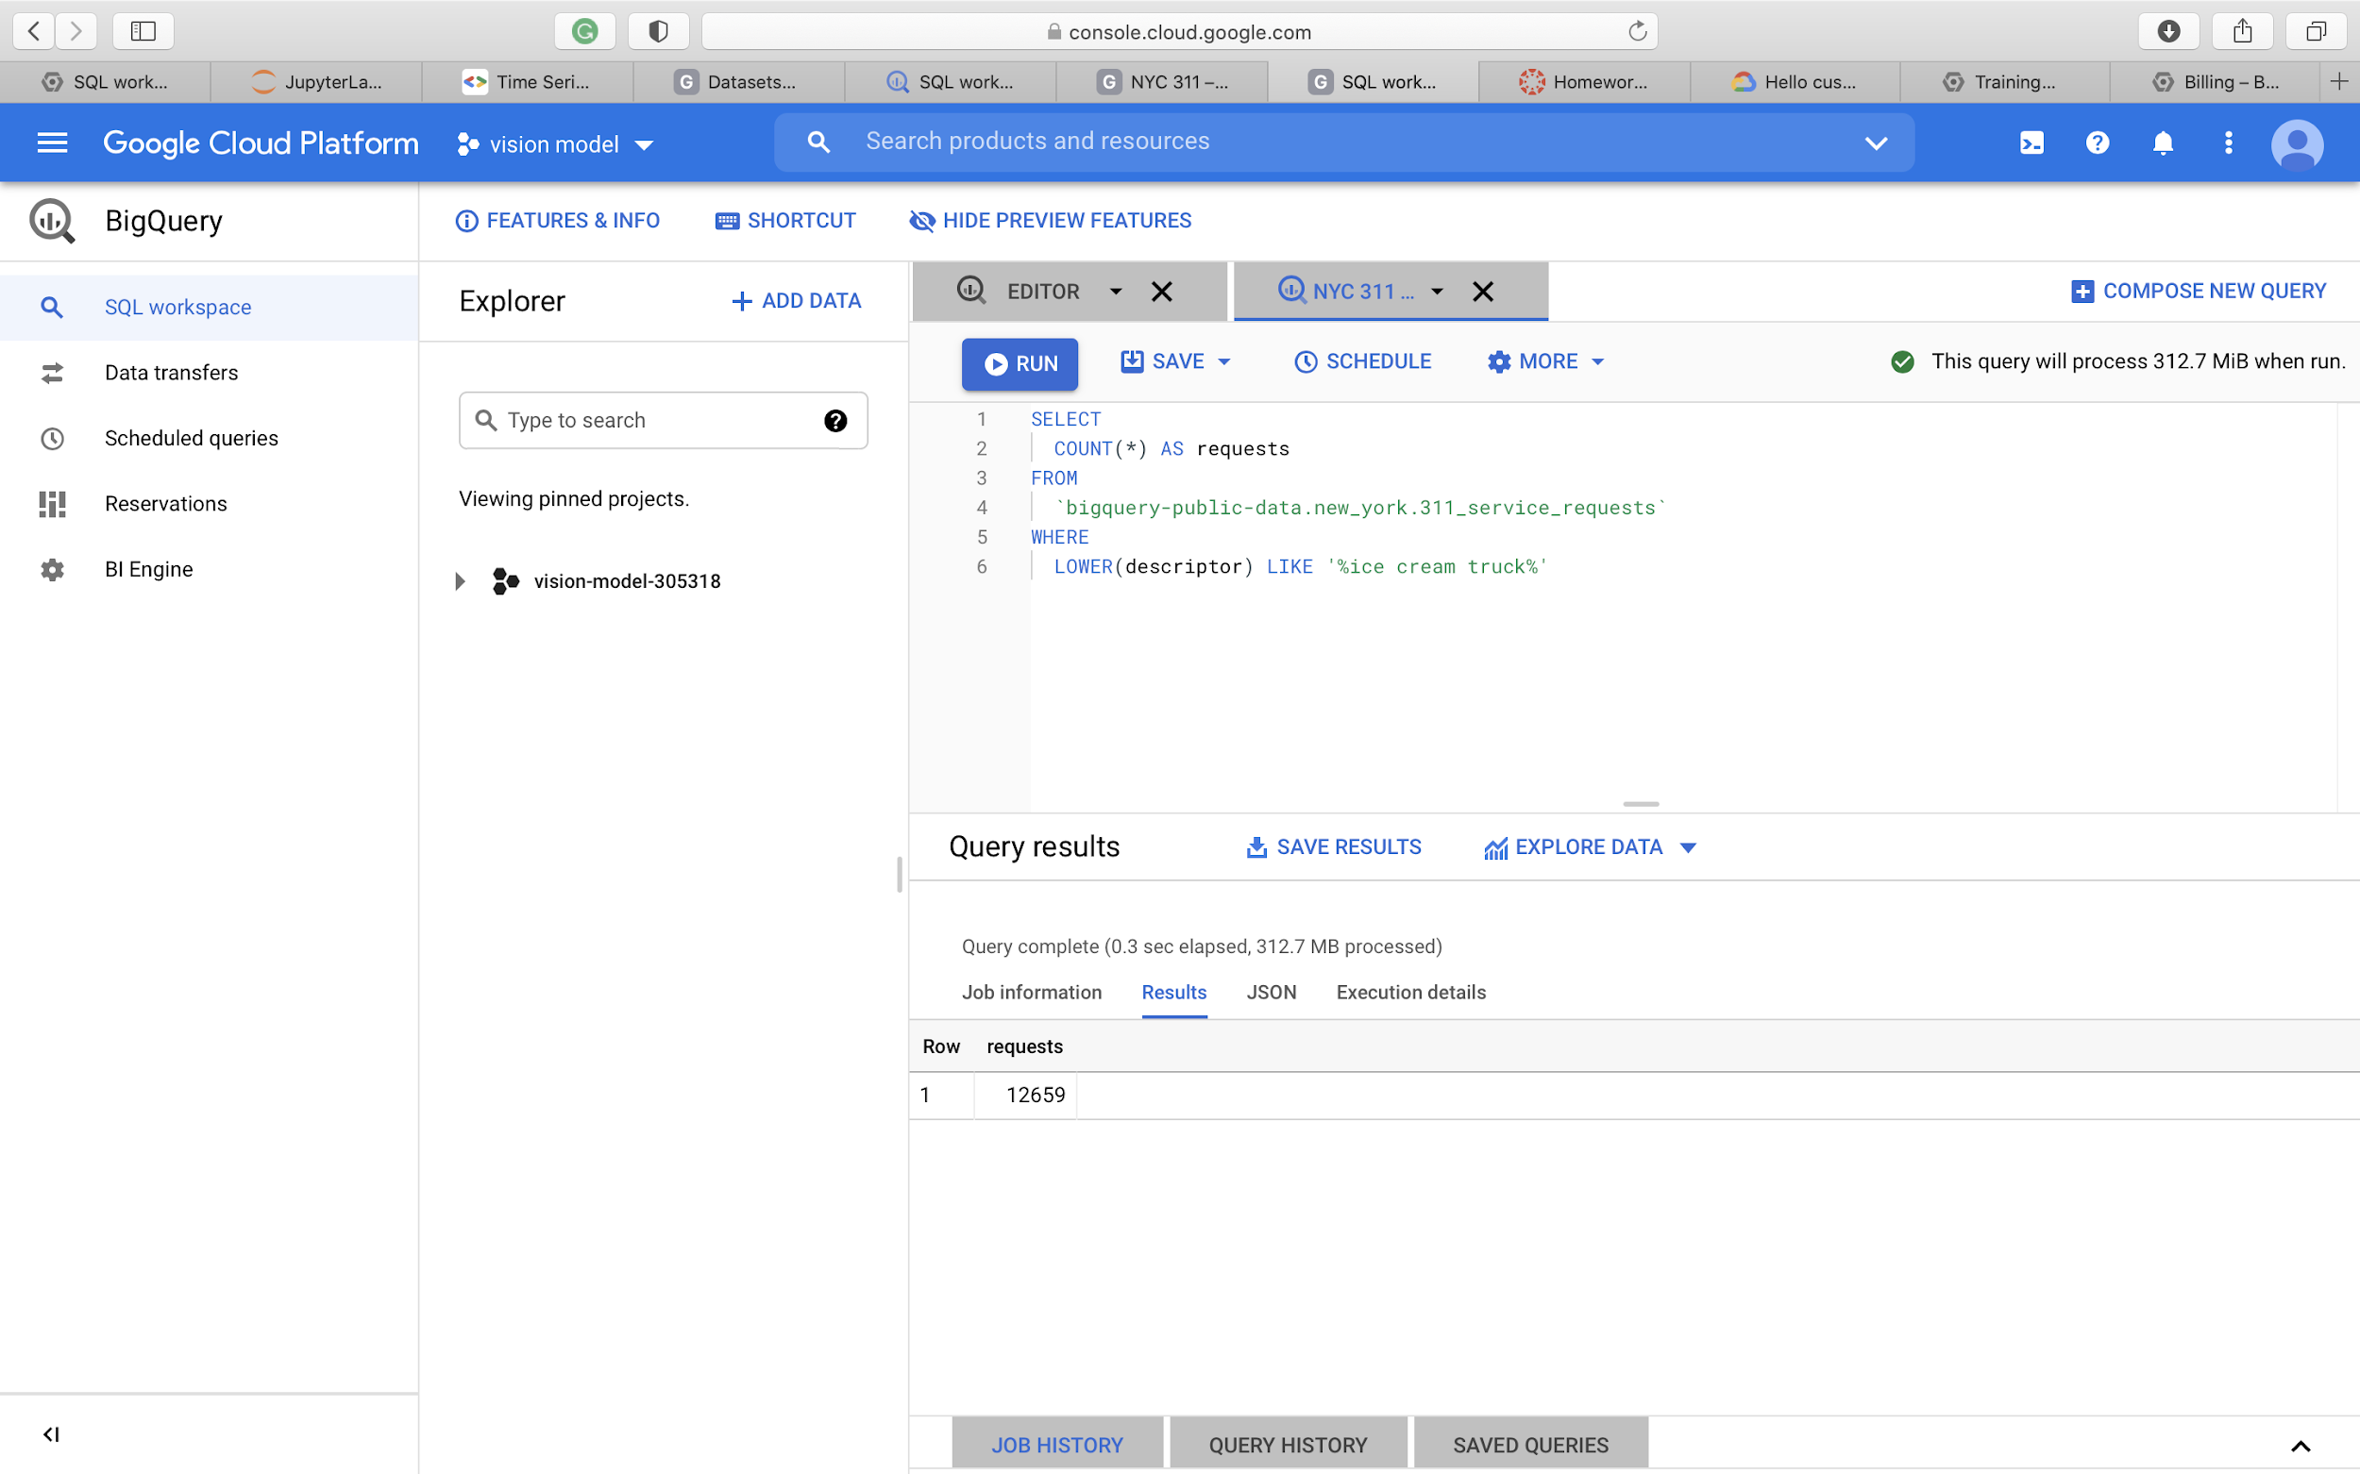

Slide 40
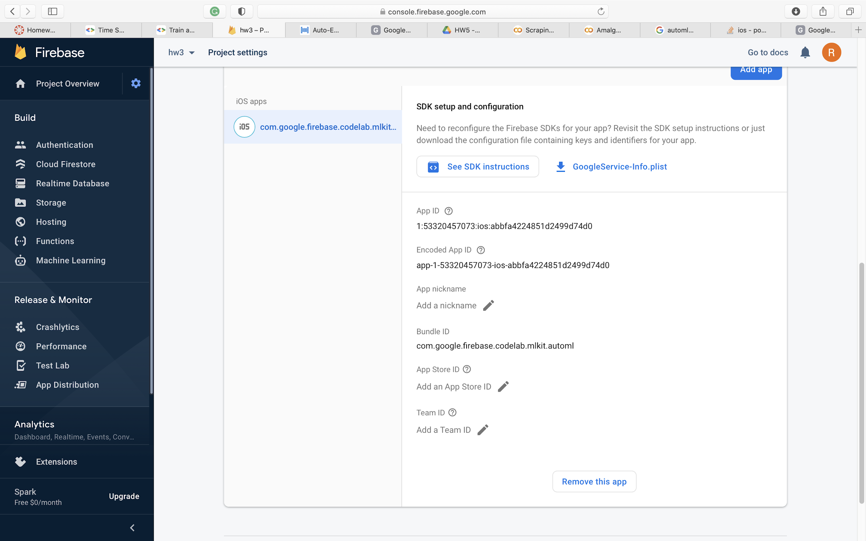
Automl to mobile app
Create project from firebase console with required configurations

Slide 41
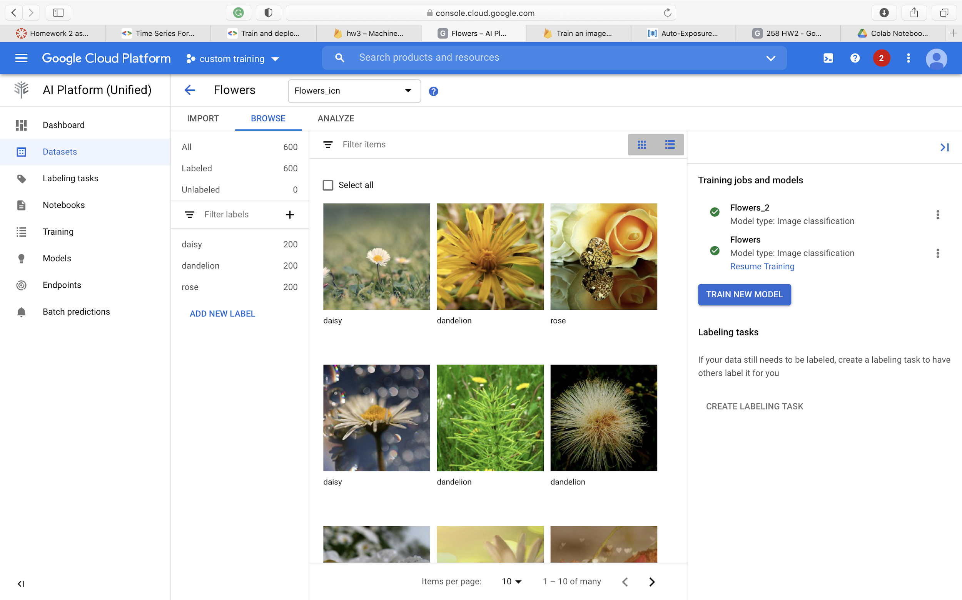
Dataset used for flower classification

Slide 42
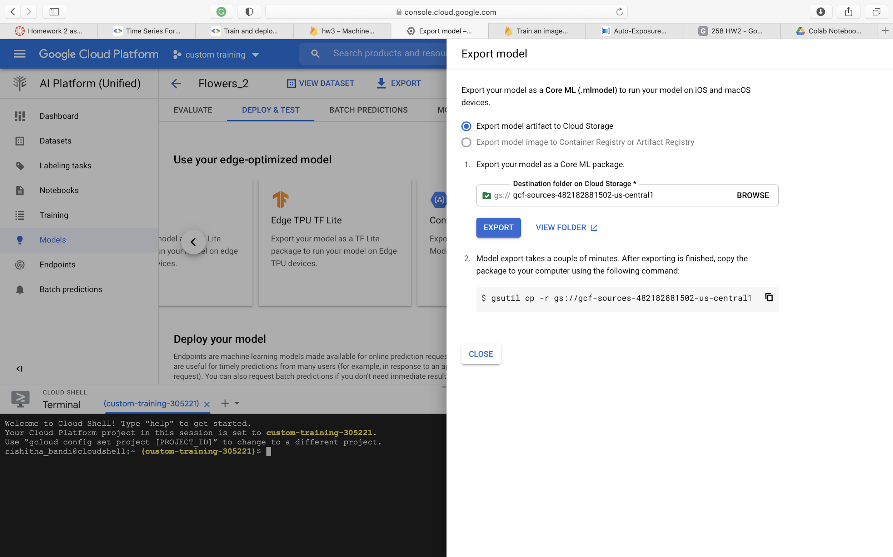
After model is trained export the model to the bucket for downloading it to the computer

Slide 43
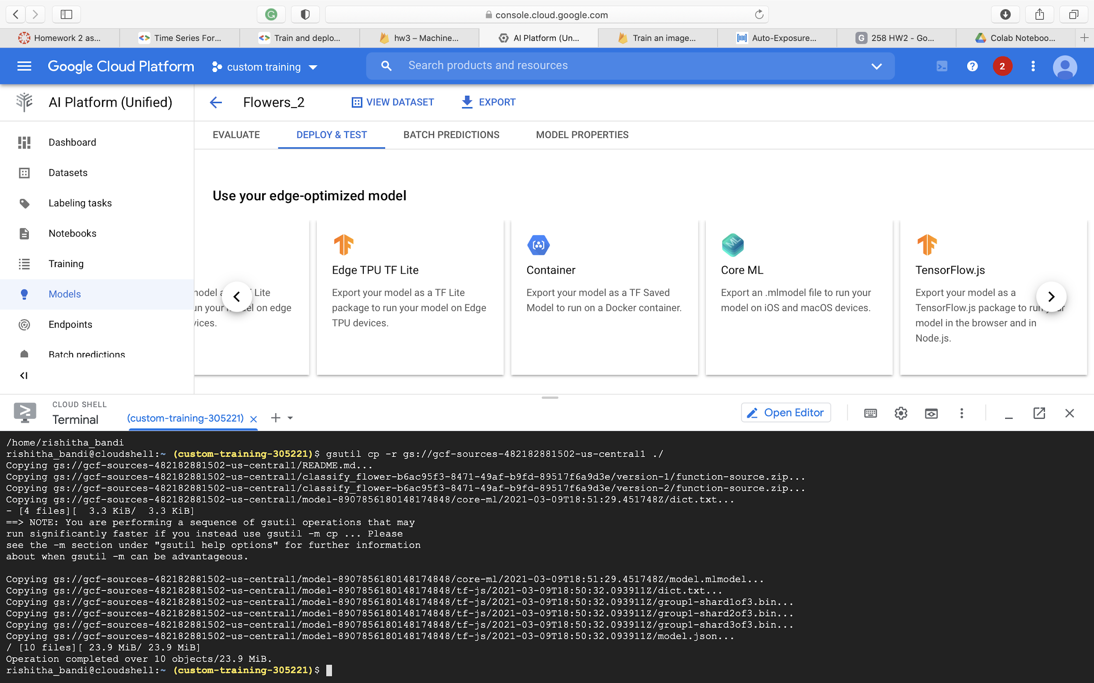
Copying from bucket to the storage

Slide 44
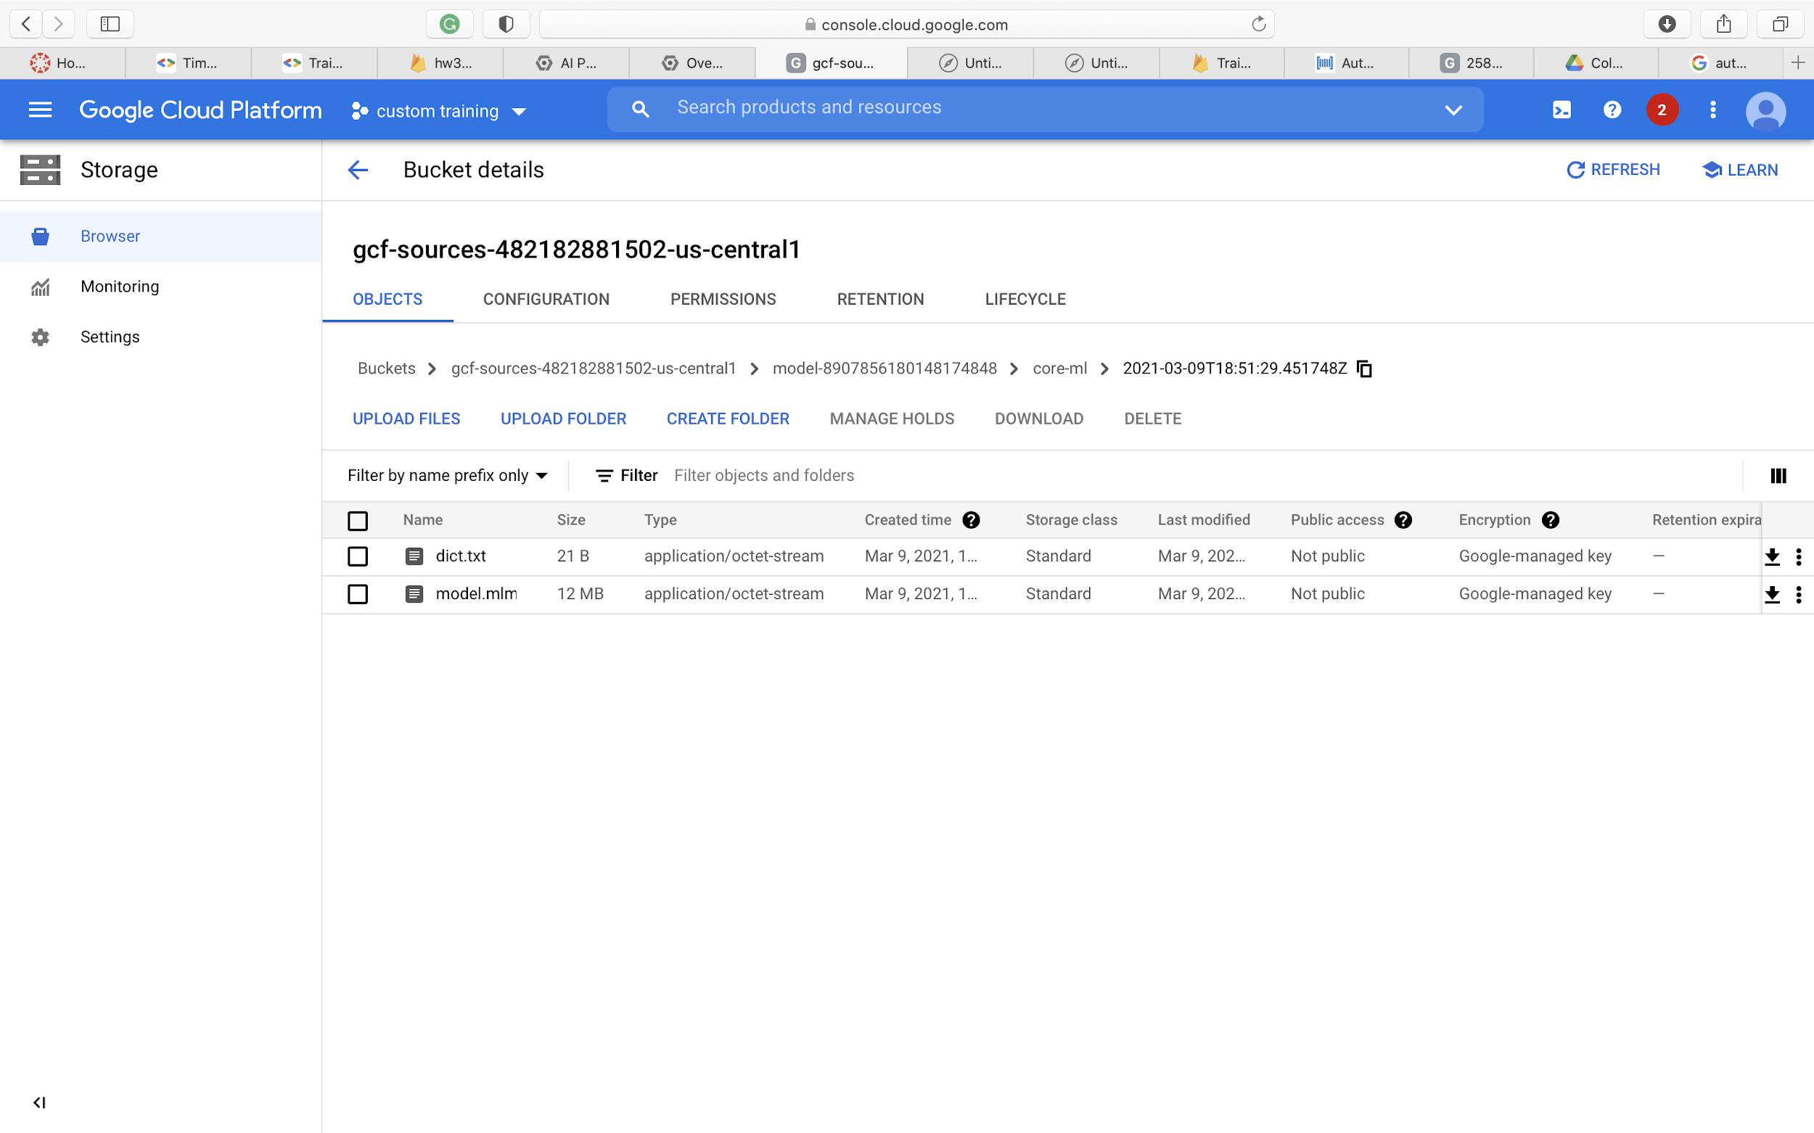
Download the model from here

Slide 45
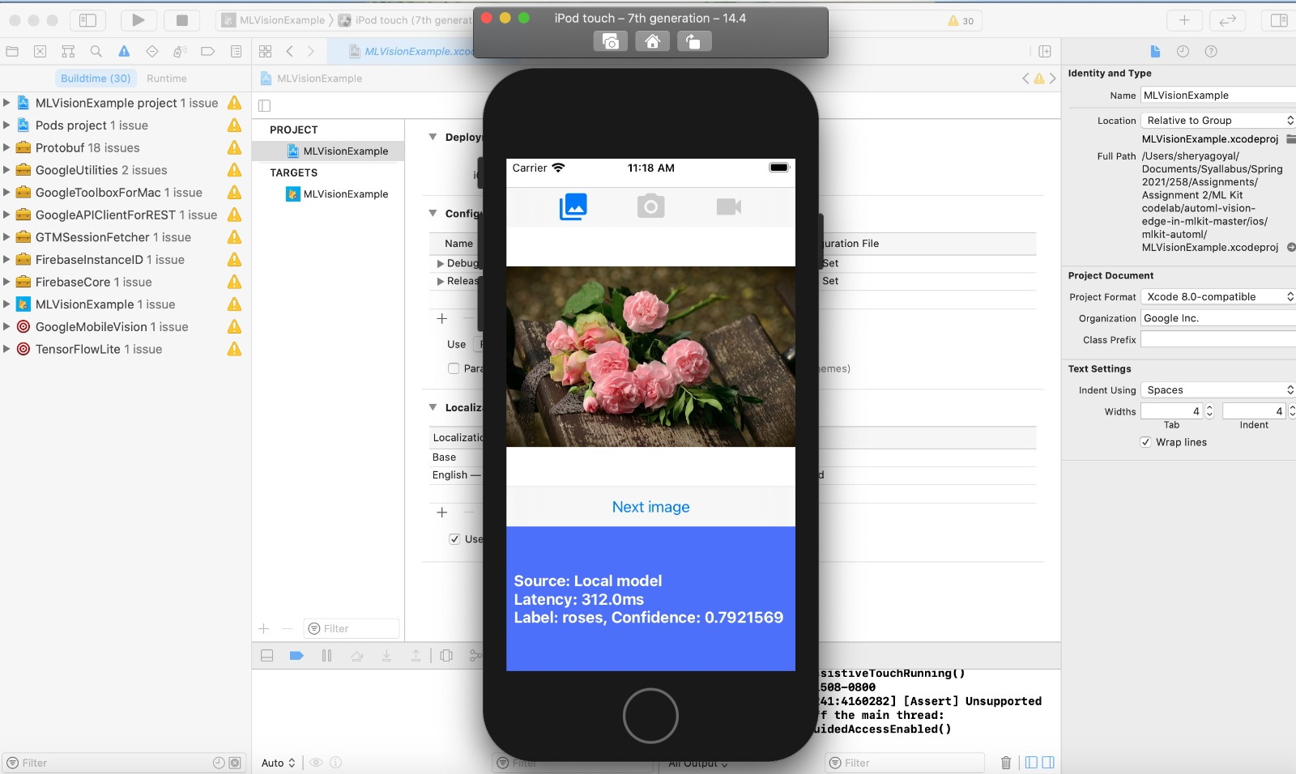
Predict the image using the mobile ios app simulator from xcode

